Slide 1
Further case studies
Or: MORE MOOOODELS
The Language of Thought: computational cognitive science approaches to category learning
Who: Fausto Carcassi
When: Sommer semester 2022

Slide 2
Where are we?
Last week, we have seen two applications of the idea of pLoT to new conceptual domains: handwritten digits and kinship systems.
This week, we’ll look at a few more applications.
It’ll be a bit of a whirlwind!
We will look at:
Learning numerals in an LoT
Learning abstract visual concepts in an LoT
Learning sequences in an LoT

Slide 3
Learning Numerals with an LoT
Piantadosi et al (2012), Bootstrapping in a language of thought: A formal model of numerical concept learning.
Children exhibit very regular patterns in the way they learn number systems.
The first learn to recognize small sets of size 1, then 2, then 3, etc.
In Carey’s formulation, early number-word meanings are represented using mental models of small sets. For instance two-knowers might have a mental model of ‘‘one’’ as {X} and ‘‘two’’ as {X, X}. These representations rely on children’s ability for enriched parallel individuation, a representational capacity that Le Corre and Carey (2007) argue can individuate objects, manipulate sets, and compare sets using one-to-one correspondence. Subset-knowers can, for instance, check if ‘‘two’’ applies to a set S by seeing if S can be put in one-to-one correspondence with their mental model of two, {X, X}
Then at about 3;6 they learn the full recursive system (Cardinal Principal learners)
This is a qualitative jump rather than continuous smooth progress.

Slide 4
Learning Numerals with an LoT
Let’s see if we can reproduce this qualitative conceptual jump with an LoT!
We have at least three choices for how to set up the LoT. Each sentence in the LoT could be:
A function from a number word to a predicate of sets
A function from a set to a number word
A function that constructs a set from the objects in the situation
Children can do all these three things, and there is no clear empirical evidence one way or the other.
In the paper, they go the second way: from a set to a number word.

Slide 5
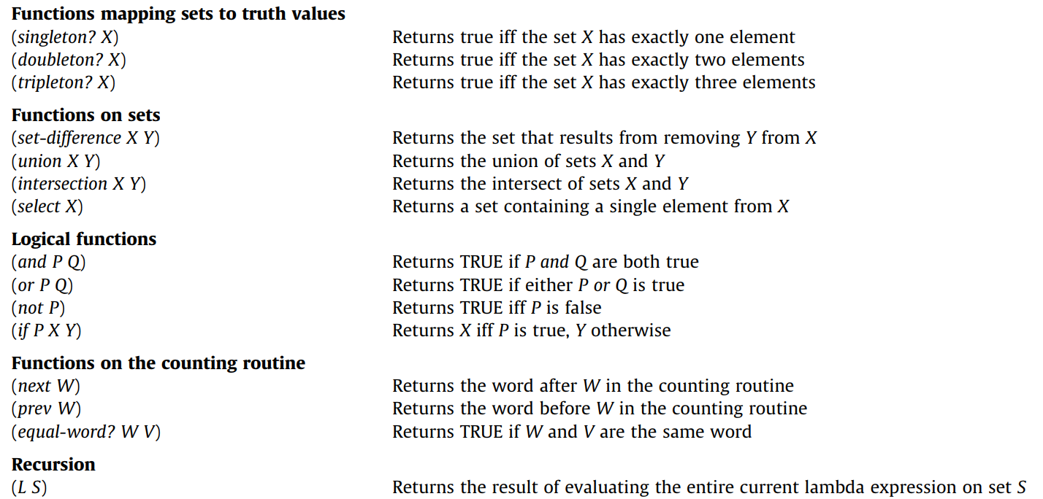
Learning Numerals with an LoT
Rules in the LoT:

Slide 6
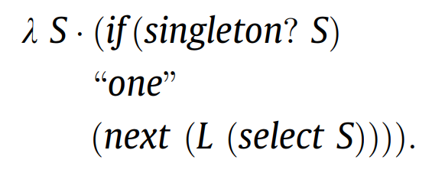
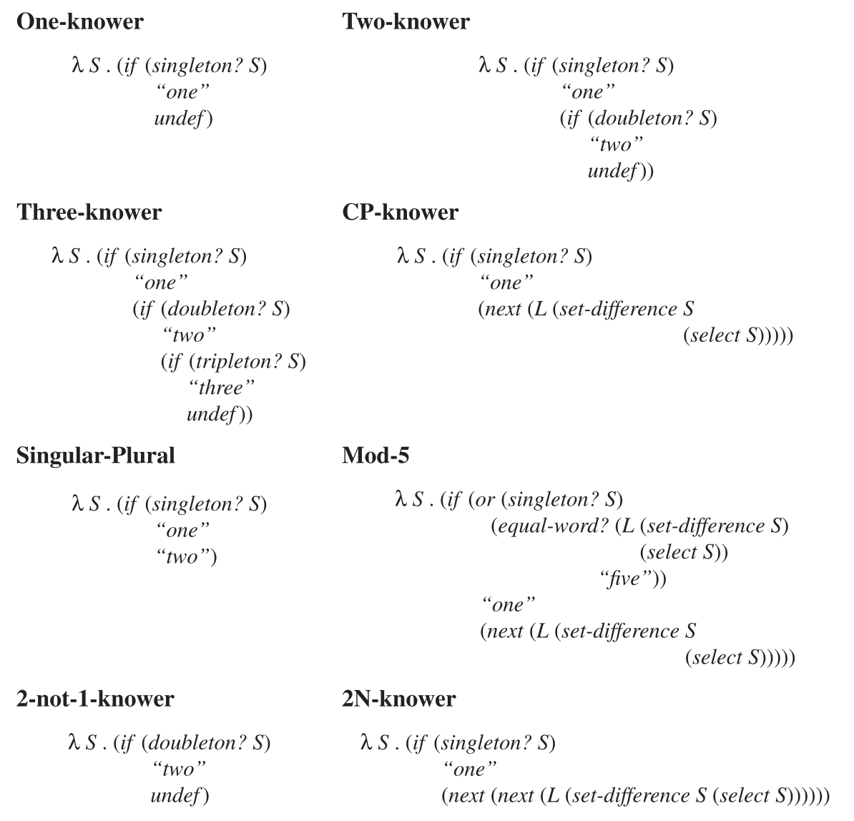
Learning Numerals with an LoT
Recursion is the only one that’s a bit complicated. What do you think the following does?

Slide 7
Learning Numerals with an LoT
The likelihood function is pretty typical:
First, a set of objects is chosen from the universe of object, e.g. ‘cats’
Second, the hypothesis is evaluated on the set.
This can result either in a number word or ‘undef’
If the result is ‘undef’, a random number word is produced
If the result is a number word, the word is produced with probability $α$ and with $1−α$ a random word is picked.
Resulting likelihood function:

Slide 8
Learning Numerals with an LoT
The model also penalizes recursive functions with a parameter $γ$
Results look strikingly like human learning patterns:
In particular, note all the hypotheses that are considered and then disregarded!

Slide 9
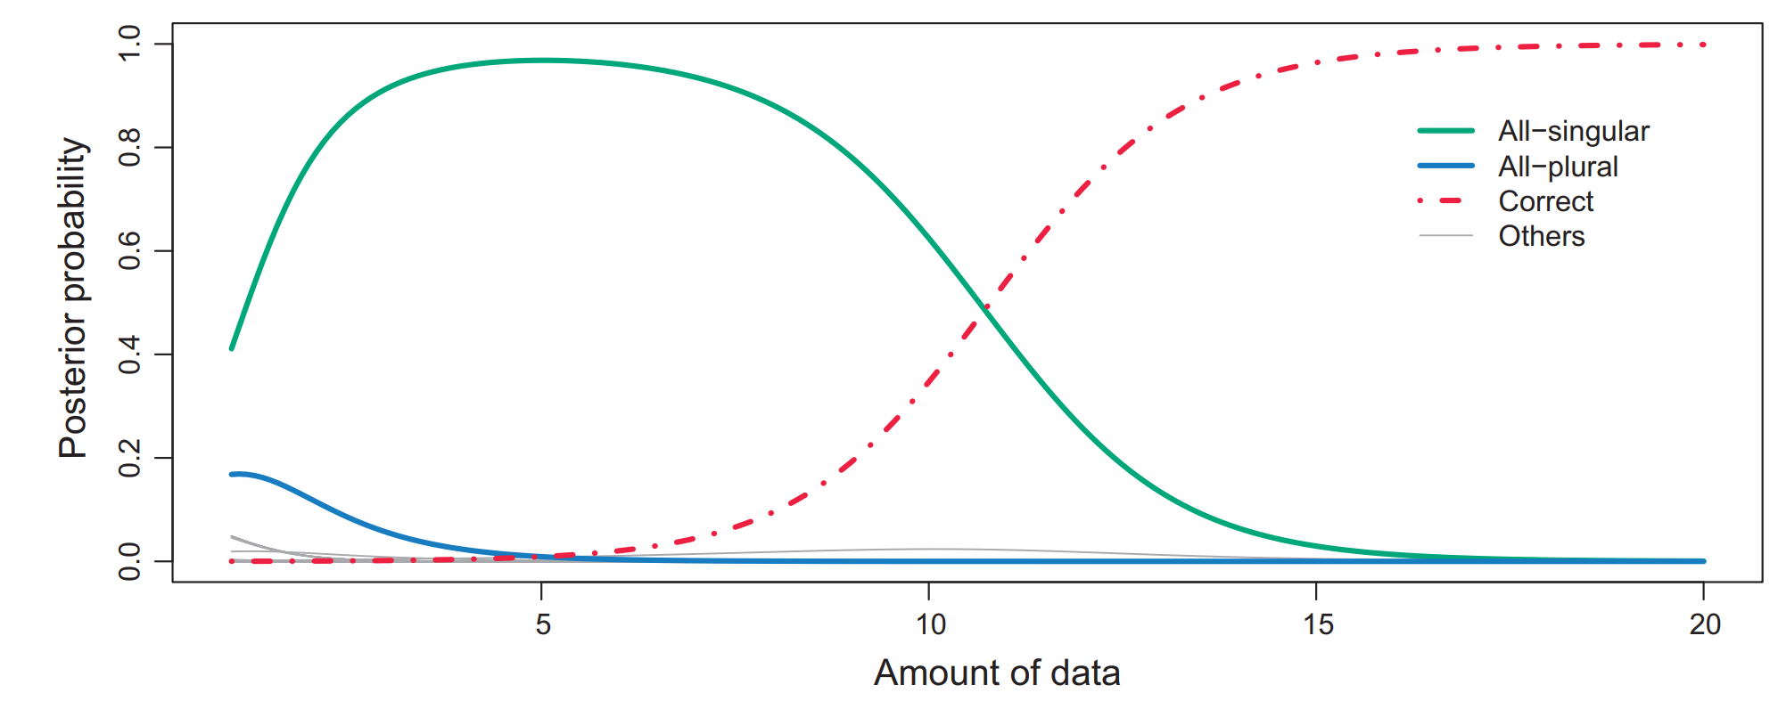
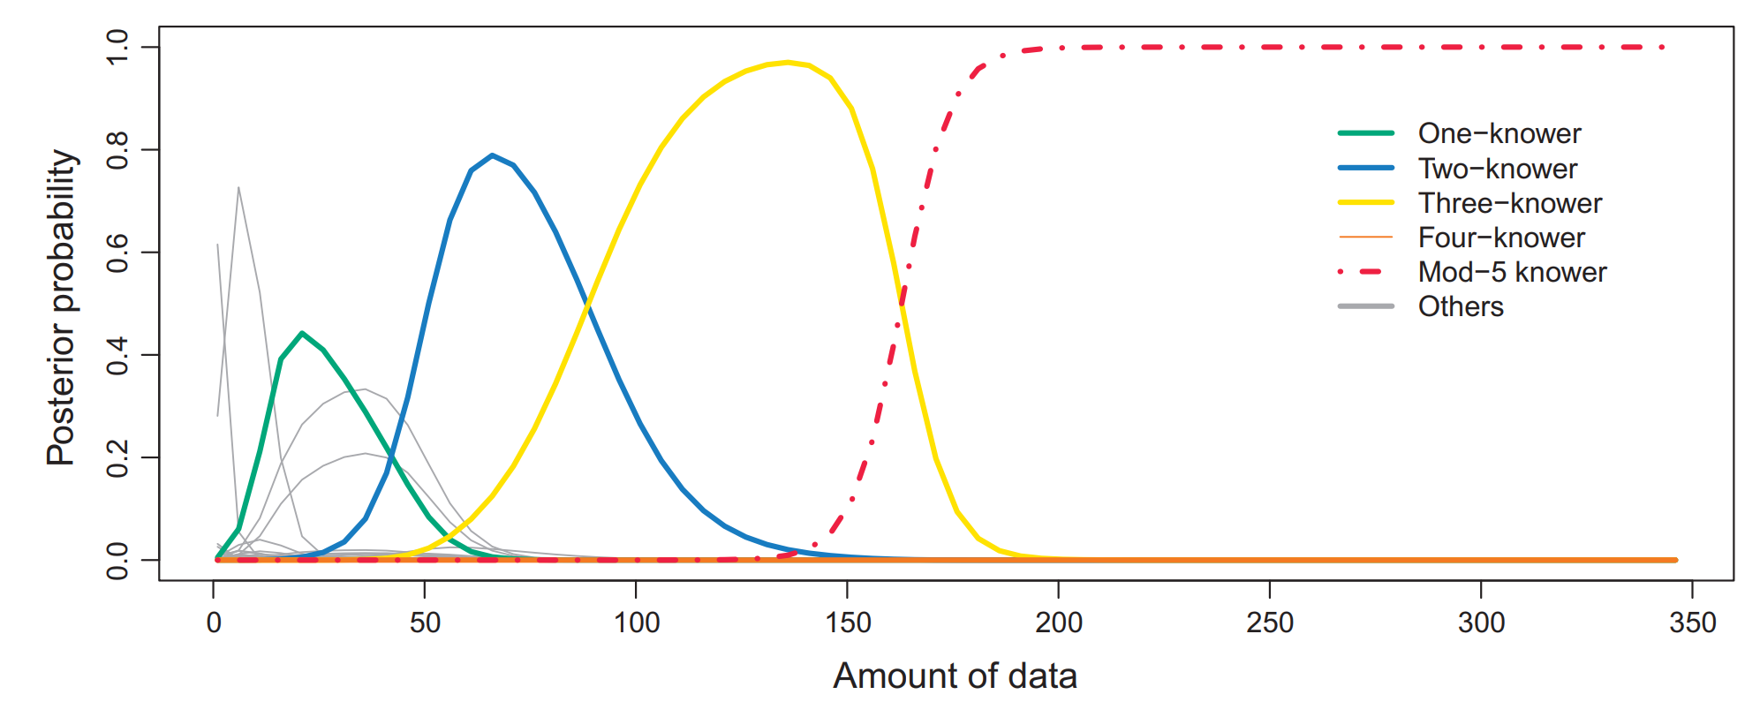
Learning Numerals with an LoT
The same LoT can also learn things like singular/plural morphology:
And mod-n systems (e.g. days of the week)

Slide 10
Visual Concept Learning in an LoT
Overlan et al (2017), Learning abstract visual concepts via probabilistic program induction in a Language of Thought
Last week, we have seen a model that can learn and do various other things with handwritten characters.
Now let’s see if we can work with something else in the visual modality, namely the structure of 3-d objects.
Suppose we have the following primitive objects, and we can combine them in various ways:

Slide 11
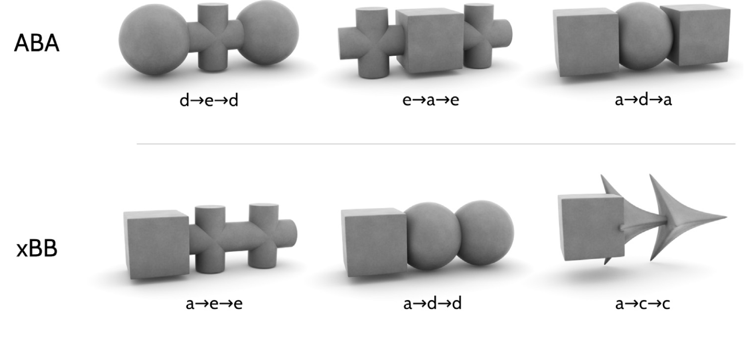
Visual Concept Learning in an LoT
For instance, we can produce the following categories:
Note that each category identifies a class of objects!

Slide 12
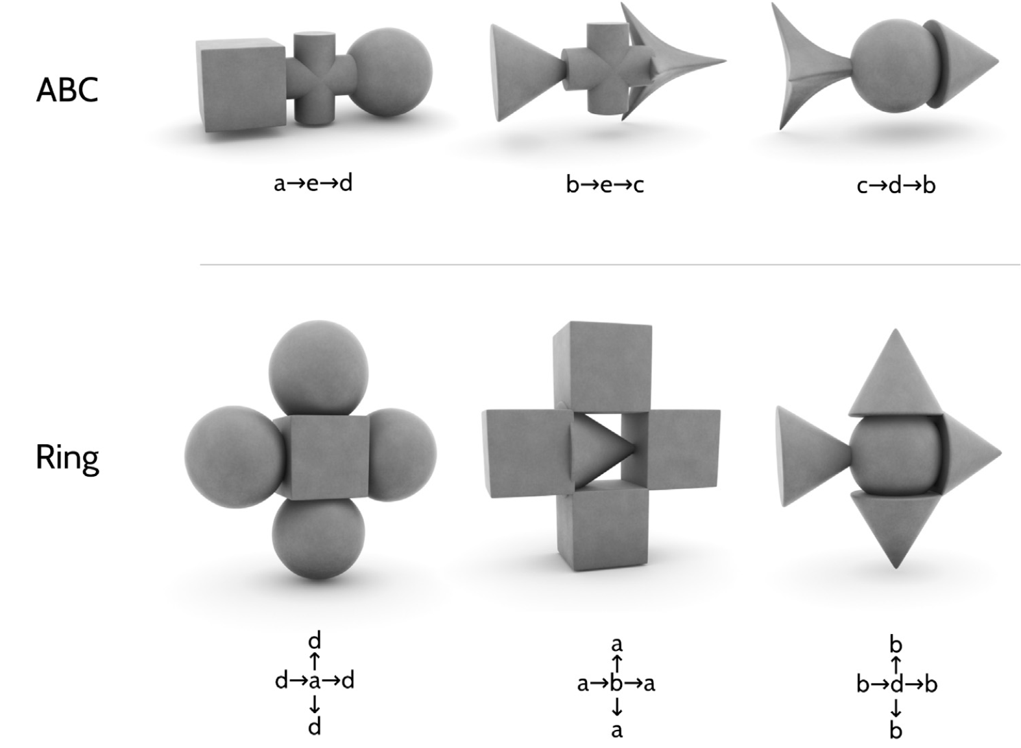
Visual Concept Learning in an LoT

Slide 13
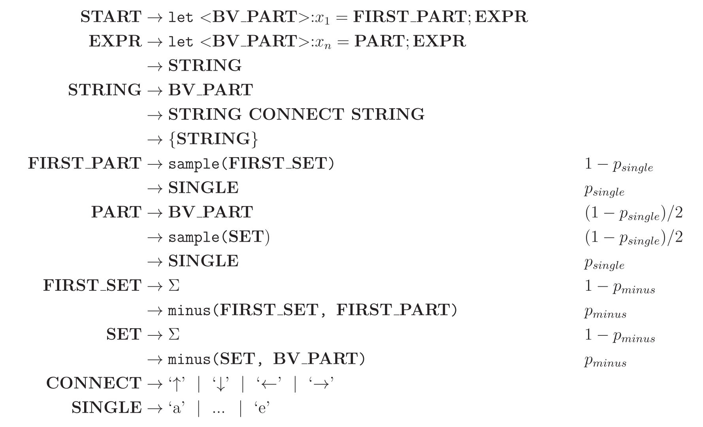
Visual Concept Learning in an LoT
What could a grammar for this look like?

Slide 14
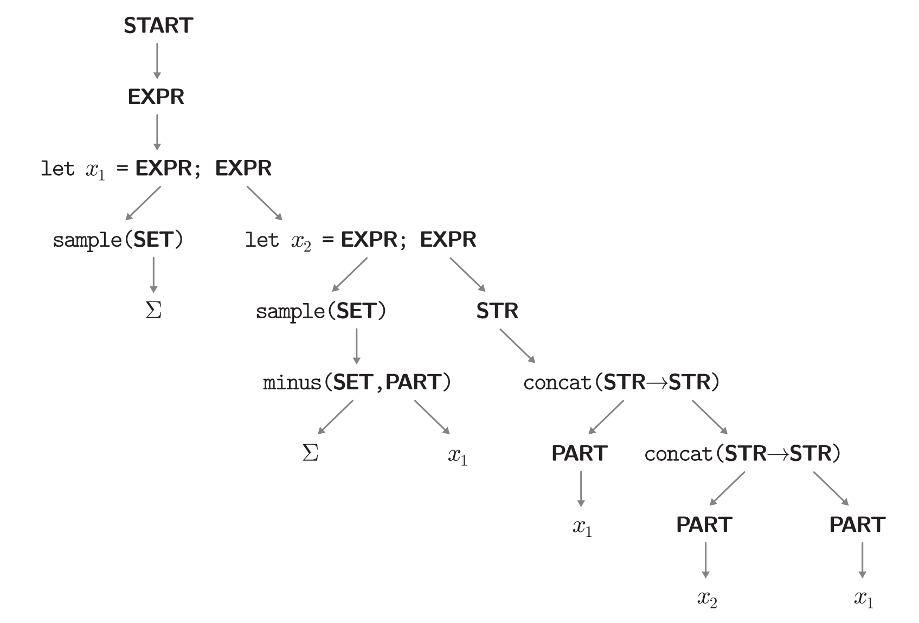
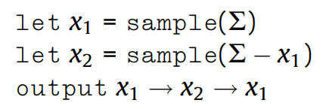
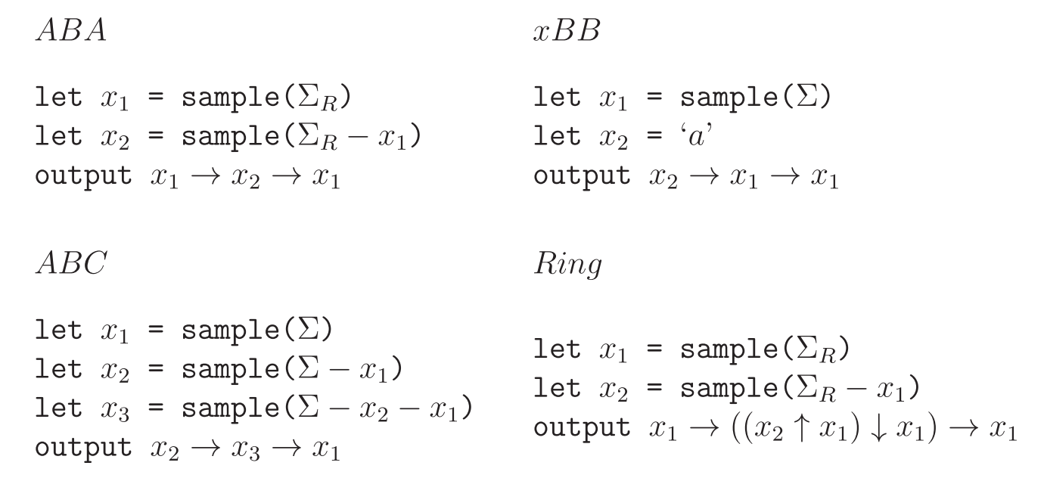
Visual Concept Learning in an LoT
Example of a derivation and some categories:

Slide 15
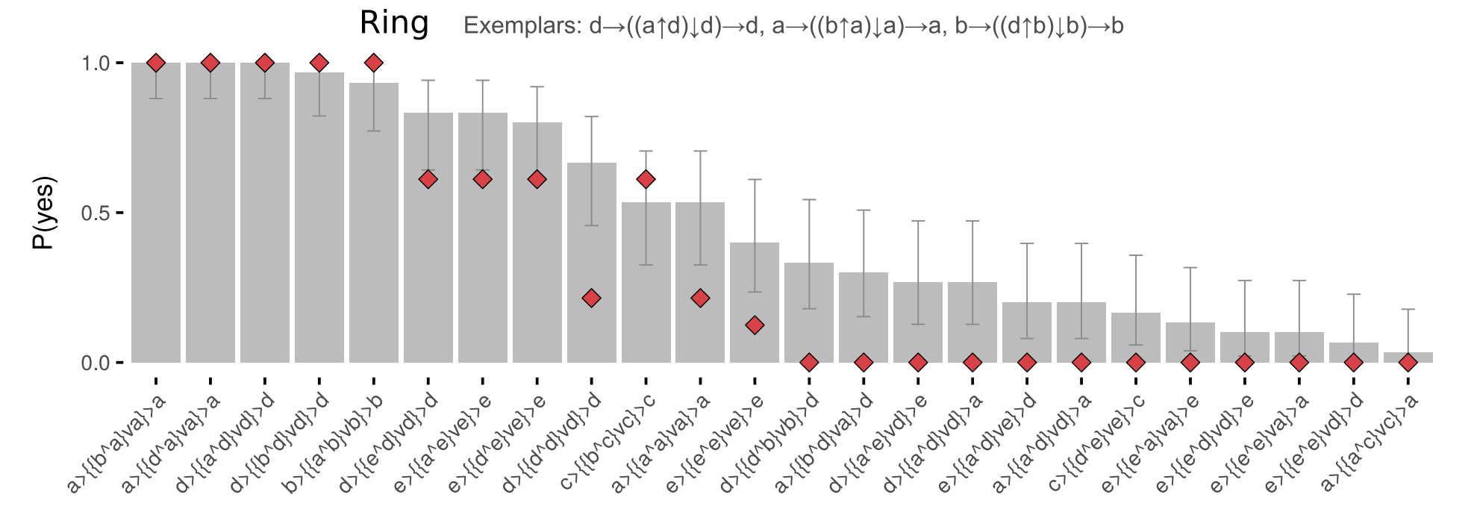
Visual Concept Learning in an LoT

Slide 16
Sequence Learning in an LoT
Planton et al (2021), A theory of memory for binary sequences: Evidence for a mental compression algorithm in humans
The scope here is to understand how humans deal with binary sequences, i.e. sequences composed of only two elements.
For instance, {0,1}*
But not that it doesn’t need to be symbols. E.g. it can be two pitches.
Much literature has been devoted to understand how humans learn these.
Usually, the general strategy is to find a mechanism where strings can be encoded, which explains how long strings can be learned, which would be impossible with pure memorization.

Slide 17
Sequence Learning in an LoT
In this case, we’ll use an LoT where each sentence can encode a binary series. For instance:
LoT:
Staying (“+0”)
Moving to the other item (here denoted ‘b’)
Repetition (“^n”, where n is any number),
Possibly with a variation in the starting point
Denoted by <x> where x is an elementary instruction, either +0 or b
Embedding of expressions is represented by brackets (“[. . ..]”) and concatenation by commas (“,”).

Slide 18
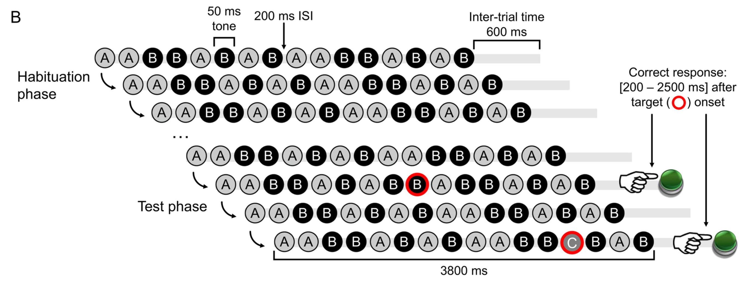
Sequence Learning in an LoT
‘Sequence violation’ experimental paradigm:
The basic hypothesis was that, for equal sequence length, error rate and response time in violation detection would increase with sequence complexity.

Slide 19
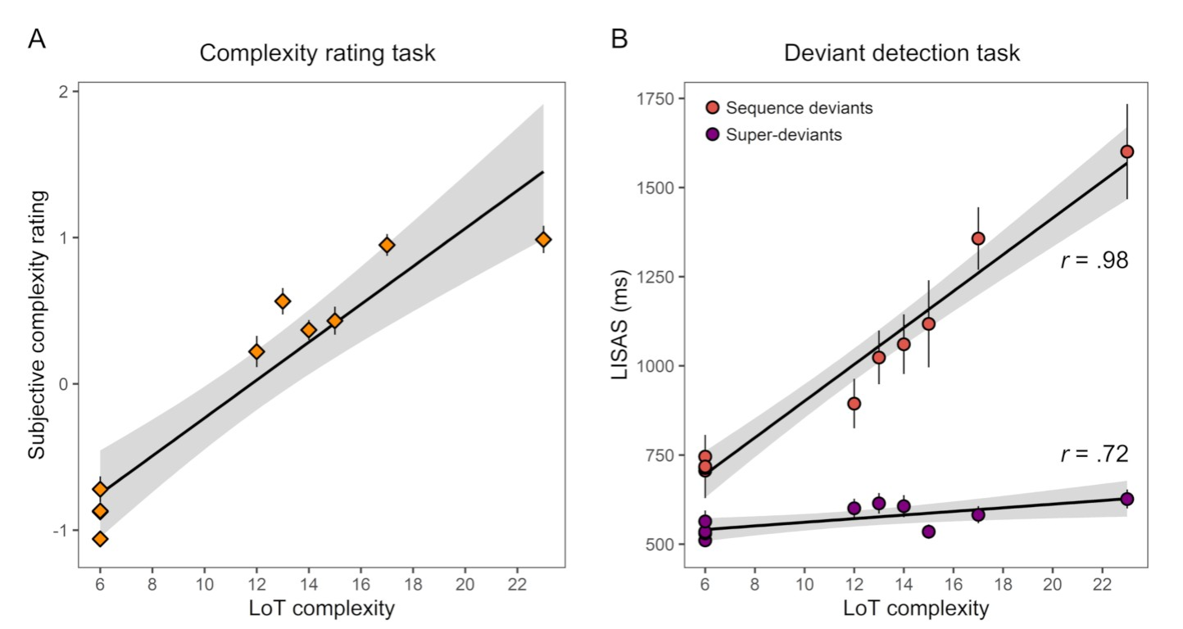
Sequence Learning in an LoT
This is the results of the first experiment
Participants were asked subjective complexity (left)
And to identify deviations in:
Sequence deviants
A note is replaces with the other note
Superdeviant
A new note is introduced
LISAS: Linear Integrated Speed-Accuracy Score

Slide 20
Summary
This week, we saw some other applications of the pLoT idea
First, we saw a model of numeral acquisition
Then, a model of learning visual concepts (categories of 3-d objects)
This could easily be extended, if you’re into 3-d rendering
Possible final project?
Finally, we saw a model of learning binary sequences of tones
In the lab this week, we’ll try to implement a model from scratch
I am not going to prepare beforehand so we can all write it together
Next week is the last week, so the lecture is going to be a review of what we’ve done, with some concluding remarks on the general project.
In the lab next week we’ll implement another model.

