Slide 1
Probabilistic program induction of symbols
Or: More complex models!
The Language of Thought: computational cognitive science approaches to category learning
Who: Fausto Carcassi
When: Sommer semester 2022

Slide 2
Where are we?
Last week we have seen a very simple application of the LoT idea to categorization with a logical language.
We have also learned more about the LOTlib3 library
However, we have not seen the full power of LoT yet compared to e.g., deep learning methods.
Today we’ll have a look at what we can do with serious LoT models!
The paper we’ll look at (Lake et al (2015), Human-level concept learning through probabilistic program induction) is a bit old now, but nonetheless very nice.
If there is time left, we’ll also have a brief look at the paper on acquisition of kinship terms.

Slide 3
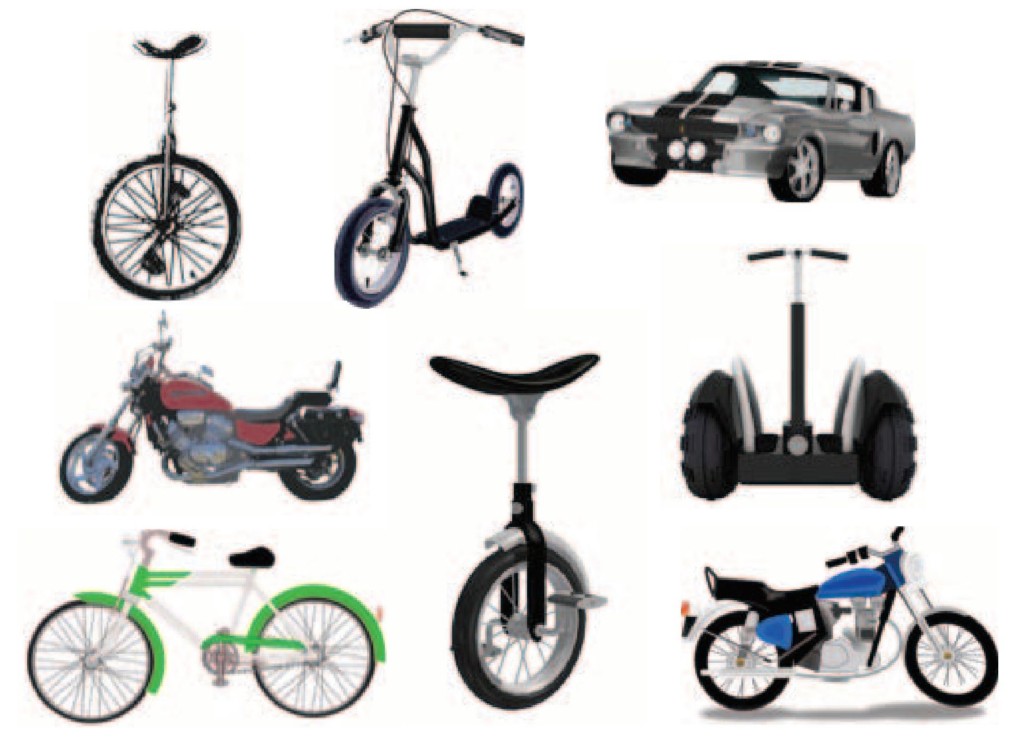
Few-shot learning
Humans can learn a huge amount from a single instance. For instance, consider the following object:
Based on just this one instance, we can do loads.
E.g., classify new examples:

Slide 4
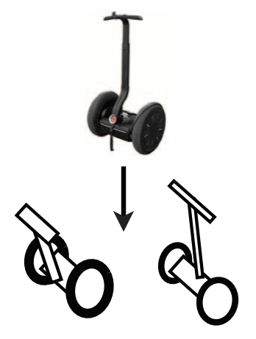
Few-shot learning
Humans can learn a huge amount from a single instance. For instance, consider the following object:
Based on just this one instance, we can do loads.
E.g., generate new examples:

Slide 5
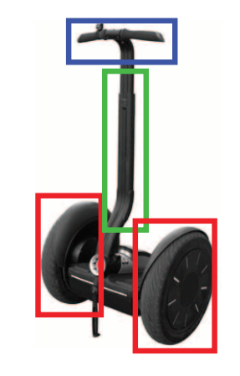
Few-shot learning
Humans can learn a huge amount from a single instance. For instance, consider the following object:
Based on just this one instance, we can do loads.
E.g., parse the object into parts:

Slide 6
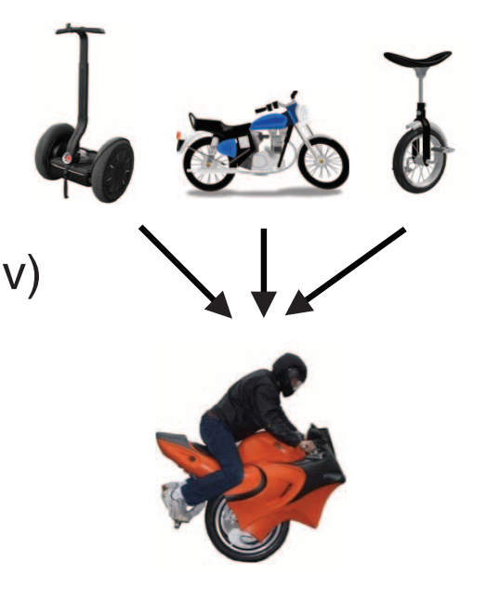
Few-shot learning
Humans can learn a huge amount from a single instance. For instance, consider the following object:
Based on just this one instance, we can do loads.
E.g., generate new concepts:

Slide 7
Cognitive problem
There is a cognitive question of how humans are capable of learning such powerful generalizations from such sparse data.
Typical machine learning algorithms only do one of these, and they usually require more data!
In the past weeks we’ve been learning a new learning algorithm, so let’s see how it performs with respect to these challenges.

Slide 8
Program induction
In order to see what the paper is going, we need a slightly different framing from what we’ve seen this far.
Consider the following problem:
We have some input-output combos from an unknown computer program
We want to infer a computer program that gives those input-outputs.
In principle, there’s many ways of doing this, e.g., genetic algorithms
You can probably see how this is related to the stuff we’ve seen this far: we can interpret inference in an LoT as a case of program induction.

Slide 9
Some fundamental ideas
The paper has very many ideas, but the main ones are to bring together:
Compositionality
Programs are build compositionally like we have seen with pLoT
Causality
The programs capture the causal structure of how the images are generated
Learning-to-learn
In addition to the things we’ve already learned, this model build a hierarchical prior, where experiences with previous concepts change the probability of new ones

Slide 10
Bayesian Program Learning
Bayesian Program Learning is introduced in Lake et al
It can learn visual concepts from a single example and generalize in a way very similar to how humans do it
In the model, concepts are represented by little computer programs that define procedures for drawing images, generated as follows in an LoT:

Slide 11
Bayesian Program Learning
Once some character types are generated in the LoT, a specific instance of a drawing of the characters can also be generated as follows:

Slide 12
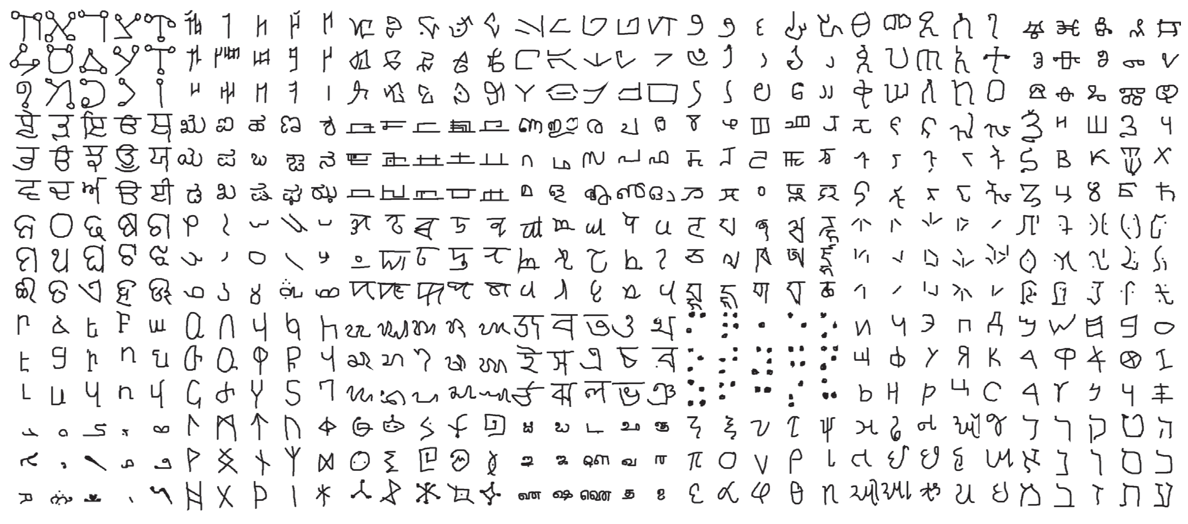
The plan
The basic idea of the paper is to test Bayesian Program Learning with 5 tasks, and compare its performance with other algorithms as well as humans.
The tasks involve the Omniglot dataset, which collects multiple examples of 1625 written characters from 50 different writing systems.
This includes both images and pen strokes

Slide 13
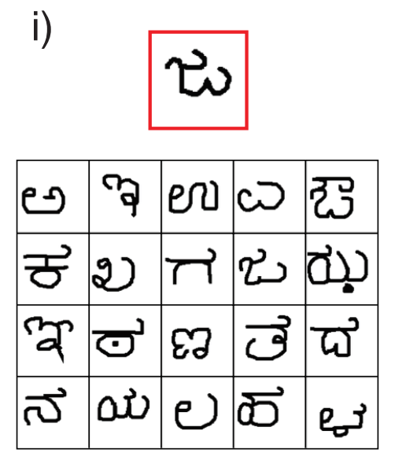
The five tasks
One-shot classification of characters:

Slide 14
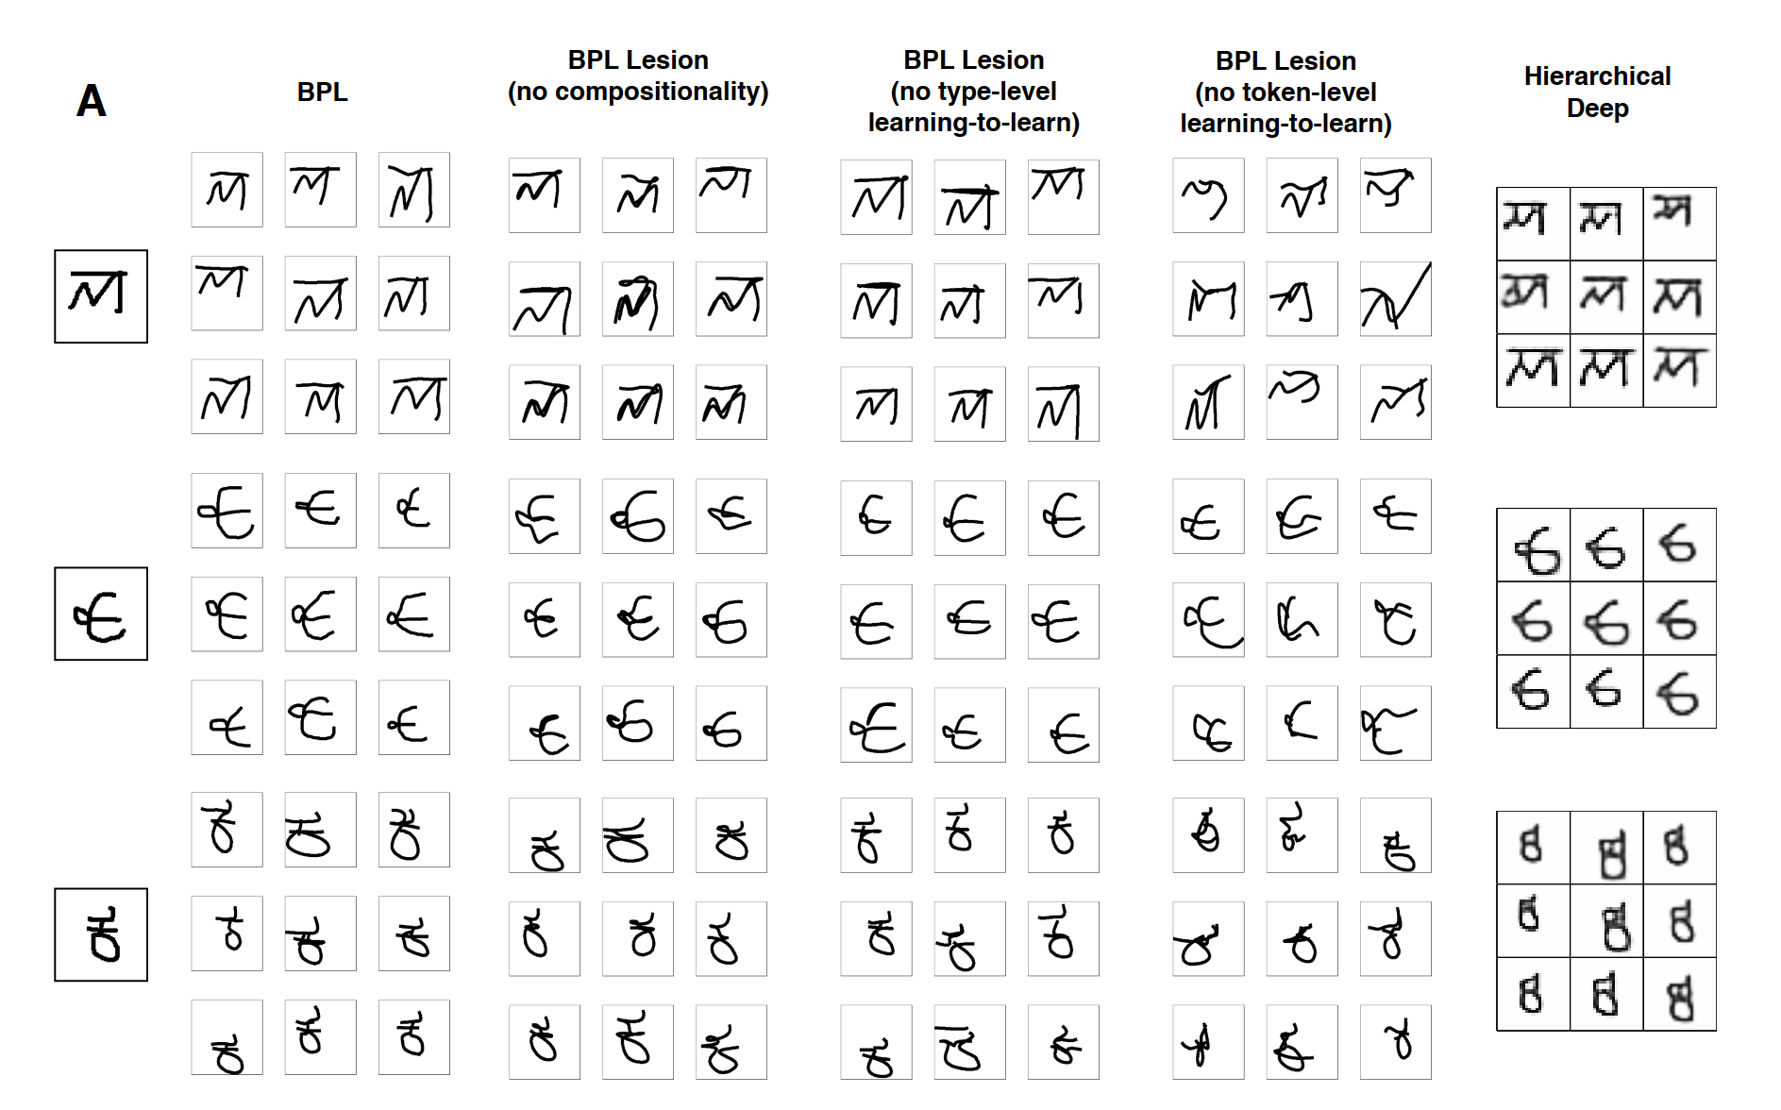
The five tasks
2. Generating new examples:

Slide 15
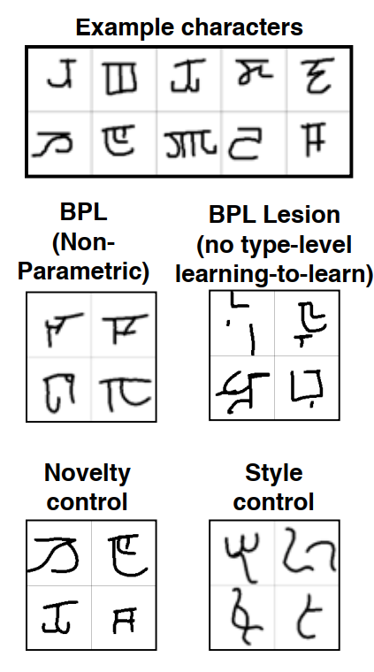
The five tasks
3. Generating new concepts:

Slide 16
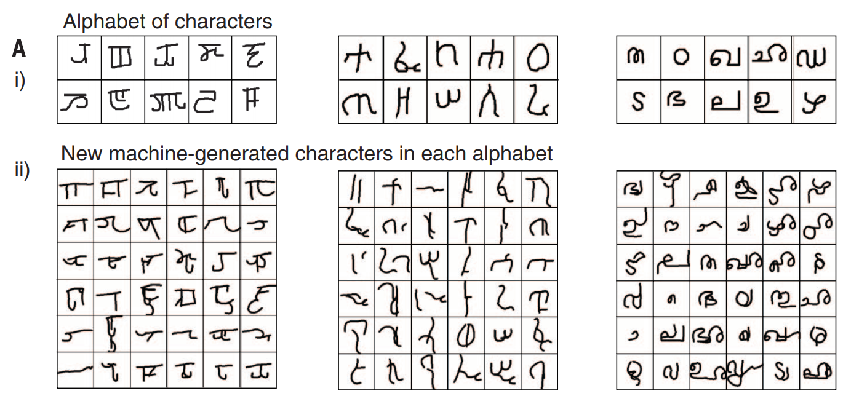
The five tasks
4. Generating new concepts (from type):

Slide 17
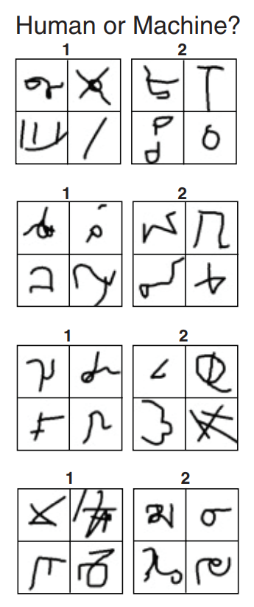
The five tasks
5. Generating new concepts (unconstrained):
(Machines are 2; 1; 1; 2)

Slide 18
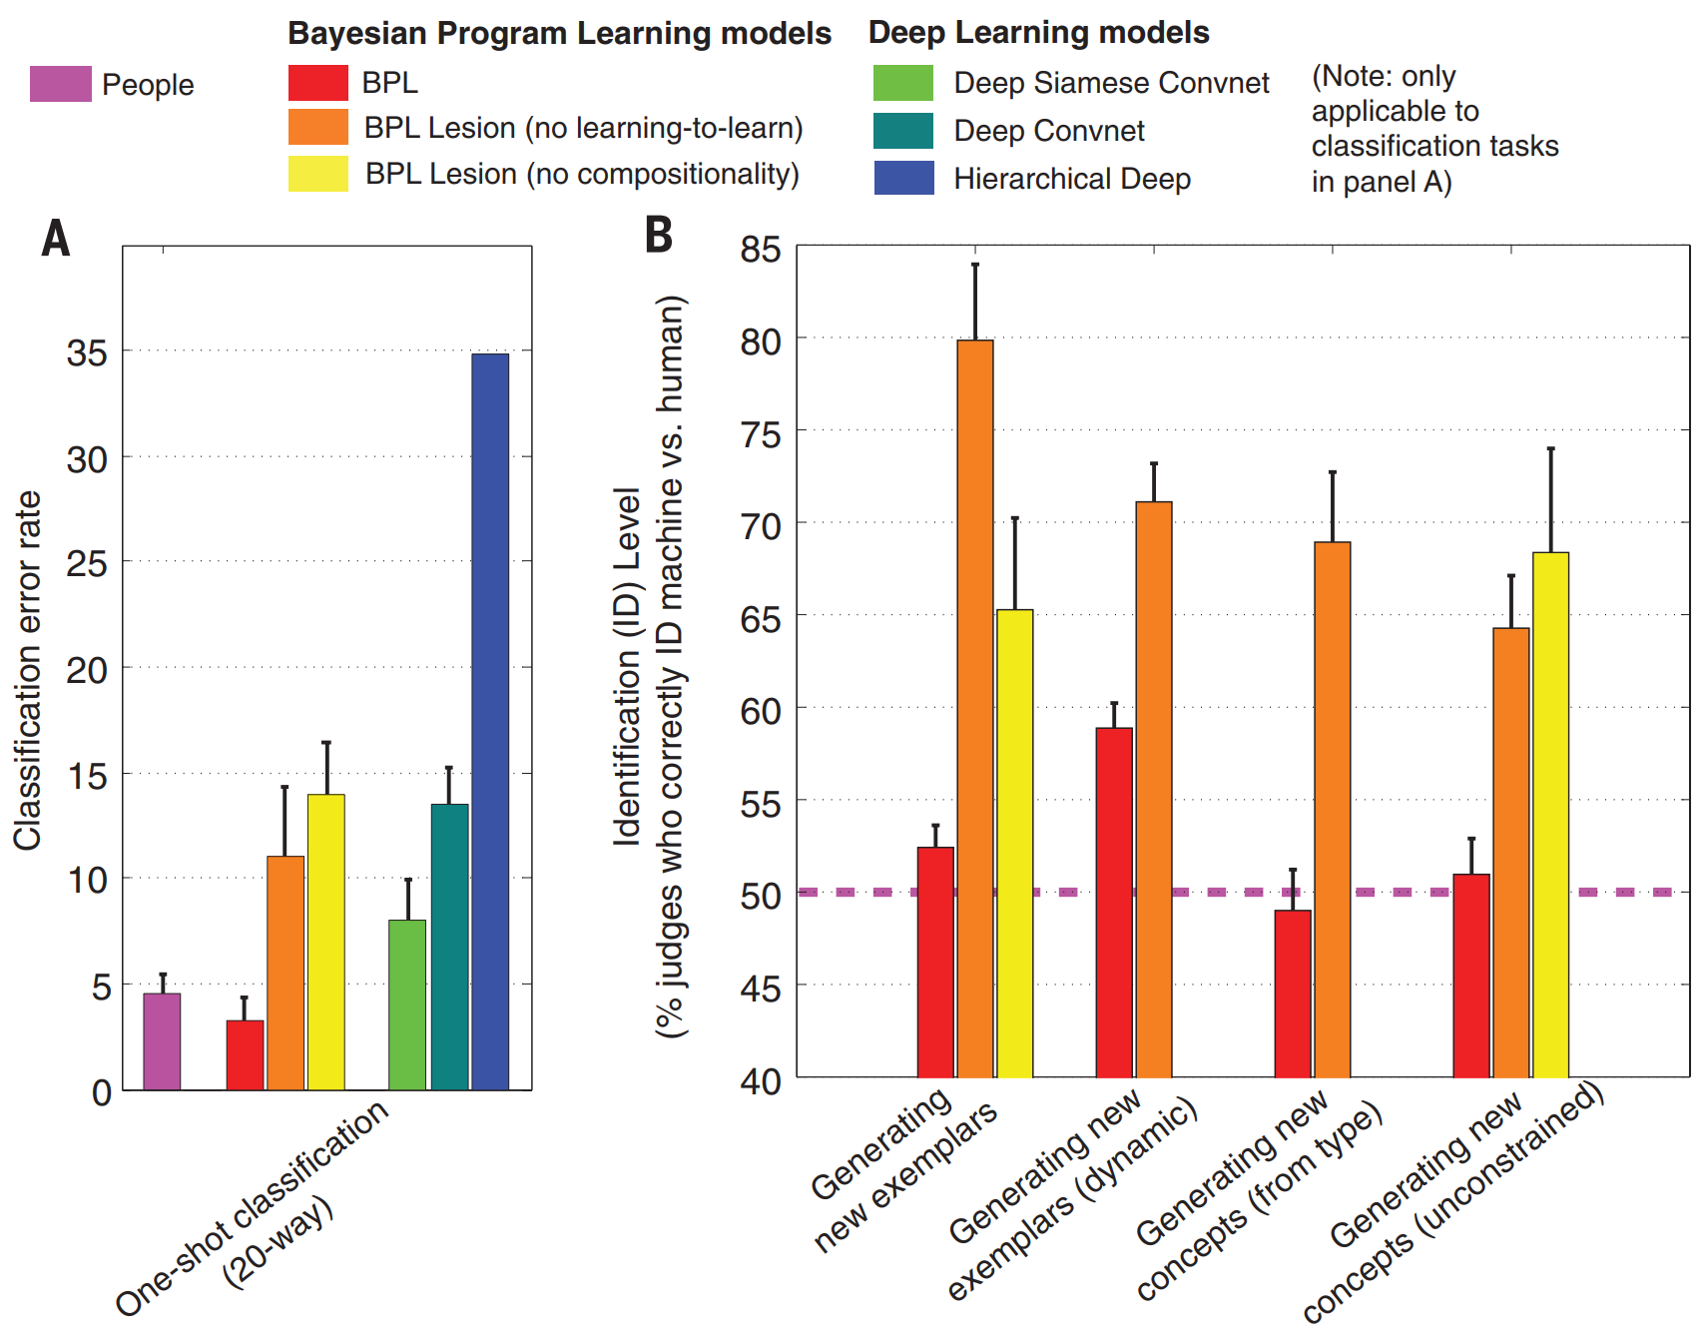
Summary of results

Slide 19
Future directions?
A natural generalization is to implement similar models for other cultural phenomena, like dances or gestures.
Another direction is to use this model to study acquisition of characters in the alphabet.
What else do you think could be done with this model?

Slide 20
Kinships terms
Let’s move onto Mollica & Piantadosi (2021), Logical word learning: The case of kinship.
Kinship terms are word used to refer to where someone is in a family with respect to someone else.
There is rich logical structure in kinship terms, since they semantically express complex relations.
This is exactly the kind of conceptual domain where LoT models shine.
So let’s look at the way the Mollica paper sets up the LoT model!

Slide 21
Kinships terms – Data
A single datapoint is a collection of four objects:
A speaker who uses the kinship word
A word (used by the speaker)
A referent identified by the word
A context, which consists of a family tree
From this kind of datapoint, the child has to infer the meaning of kinship terms!

Slide 22
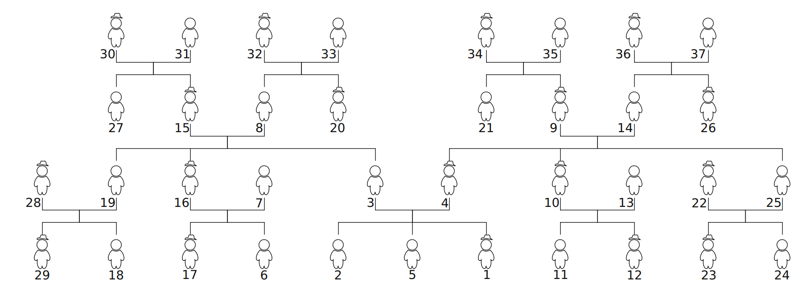
Kinships terms – Hypothesis space
A hypothesis is a function that characterizes a set of people in a family from the point of view of the speaker.
The model considers 37 possible people (here numbered by the rank of number of interactions with the speaker):

Slide 23
Kinships terms – PCFG induced prior
The PCFG contains the following primitives:
Prior probabilities are calculated as usual! E.g.,

Slide 24
Kinships terms – Likelihood function
The data is generated in one of two ways:
With probability $α$, the data is generated by the hypothesis (i.e. one of the people is sampled)
With probability $1−α$, the data is generated randomly.
This produces the following likelihood function:

Slide 25
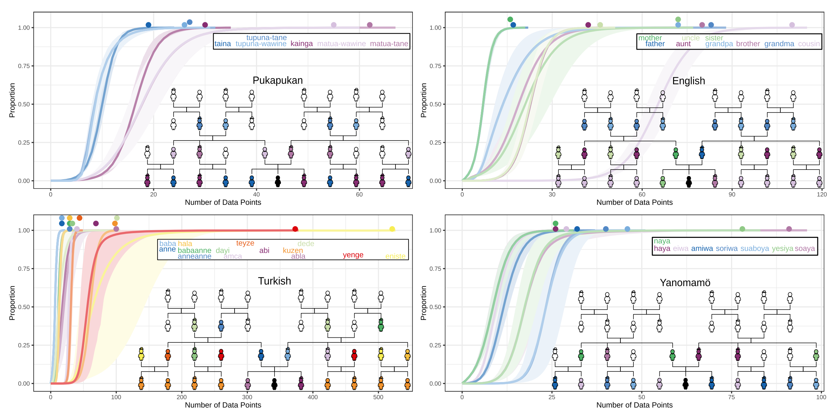
Learning kinship systems in some langs

Slide 26
Main properties of the model
The model shows a preference for concrete reference (single individuals) over classes of individuals when there are few datapoints.
This is consistent with what children do!
The model predicts overextension
The phenomenon where children learn a larger category that includes more individuals than the word’s true reference.
Characteristic-to-defining shift
A pattern in overextension where young children over-extend with characteristic features (“robbers are mean”) vs defining features (“robbers steal things”).

Slide 27
Main properties of the model
Order of acquisition of model and children mostly align:
The paper contains much more, including experimental results, but we do not have time to go through it all.

Slide 28
Summary
Today, we have seen two new applications of the LoT, in the guise of program induction: learning a computer program in a domain-specific language from input/output relations.
In the lab this week, we will see how to implement a category learning model in LOTlib3. If there’s time left we’ll also try to expand it to make it do more powerful stuff.
Next week, we will see how to apply pLoT to other domains.

