Slide 1
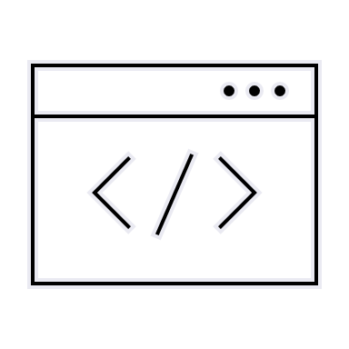
Computational approaches
to the explanation
of universal properties of meaning
Fausto Carcassi & Jakub Szymanik
https://thelogicalgrammar.github.io/ESSLLI22_langevo

Slide 2
Tradeoff between pressures
Finding a compromise

Slide 3
Different pressures act together
In the previous lectures, we have considered the effect of individual pressures
Learnability
Complexity
Cultural evolution
However,
Learnability and complexity alone predict degenerate languages
Cultural evolution alone (w/ assumptions) predicts prior distribution
More likely: language is the result of a compromise btw competing pressures
Some pressures make language simpler / easier to learn
Some pressures make language well-adapted for use, e.g., communication
Two general strategies to study this

Slide 4
Approach I: Finding the Pareto frontier
The Pareto front is the set of all Pareto efficient solutions to a problem with multiple dimensions to optimize.
A Pareto efficient solution is one such that there are no other solutions that are better in some dimensions and at least as good in all others.
In other words, to improve in one dimensions, you have to give up something!
As Jakub anticipated yesterday, one explanation: languages find the best compromise between competing pressures.
What pressures might act on language evolution?

Slide 5
Approach II: IL + communication
Second strategy: Use IL in a population of multiple agents, but make it more likely for languages with higher communicative success to become teachers.
Many modelling details to iron out!

Slide 6
Case Study I: Kinship

Slide 7
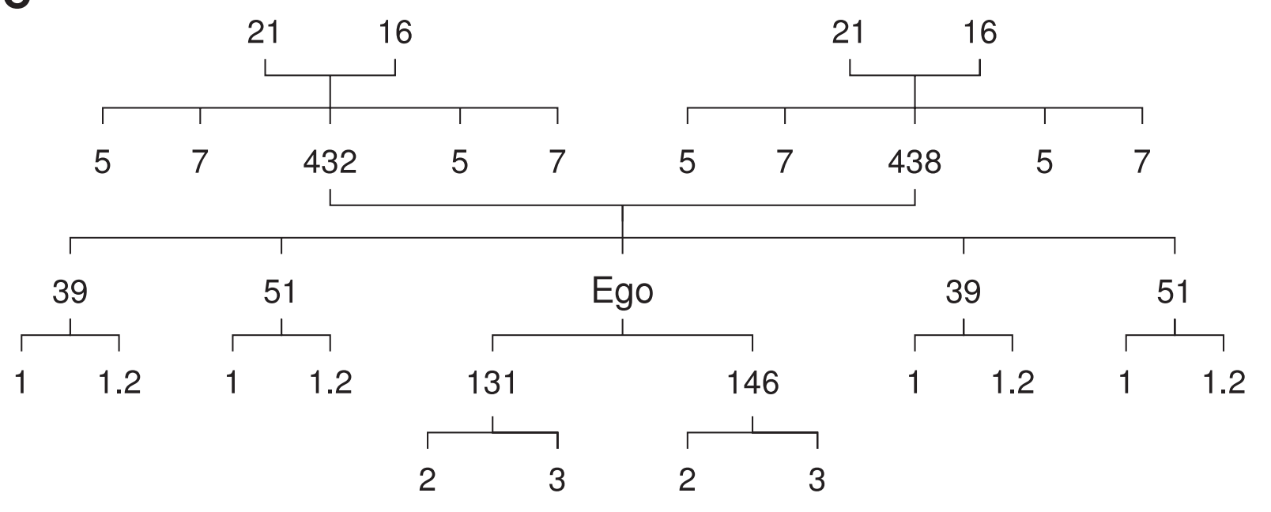
General problem
Kinship systems (Kemp and Regier 2012)
Murdoch dataset includes kin classification systems for 566 languages.
Complete systems for 487 languages
410 distinct categories (out of 10^55)
Relative frequencies of kin expressions of the form “my grandmother,” “my mother,” “my daughter,” “my granddaughter,” and the like across corpora for two languages

Slide 8
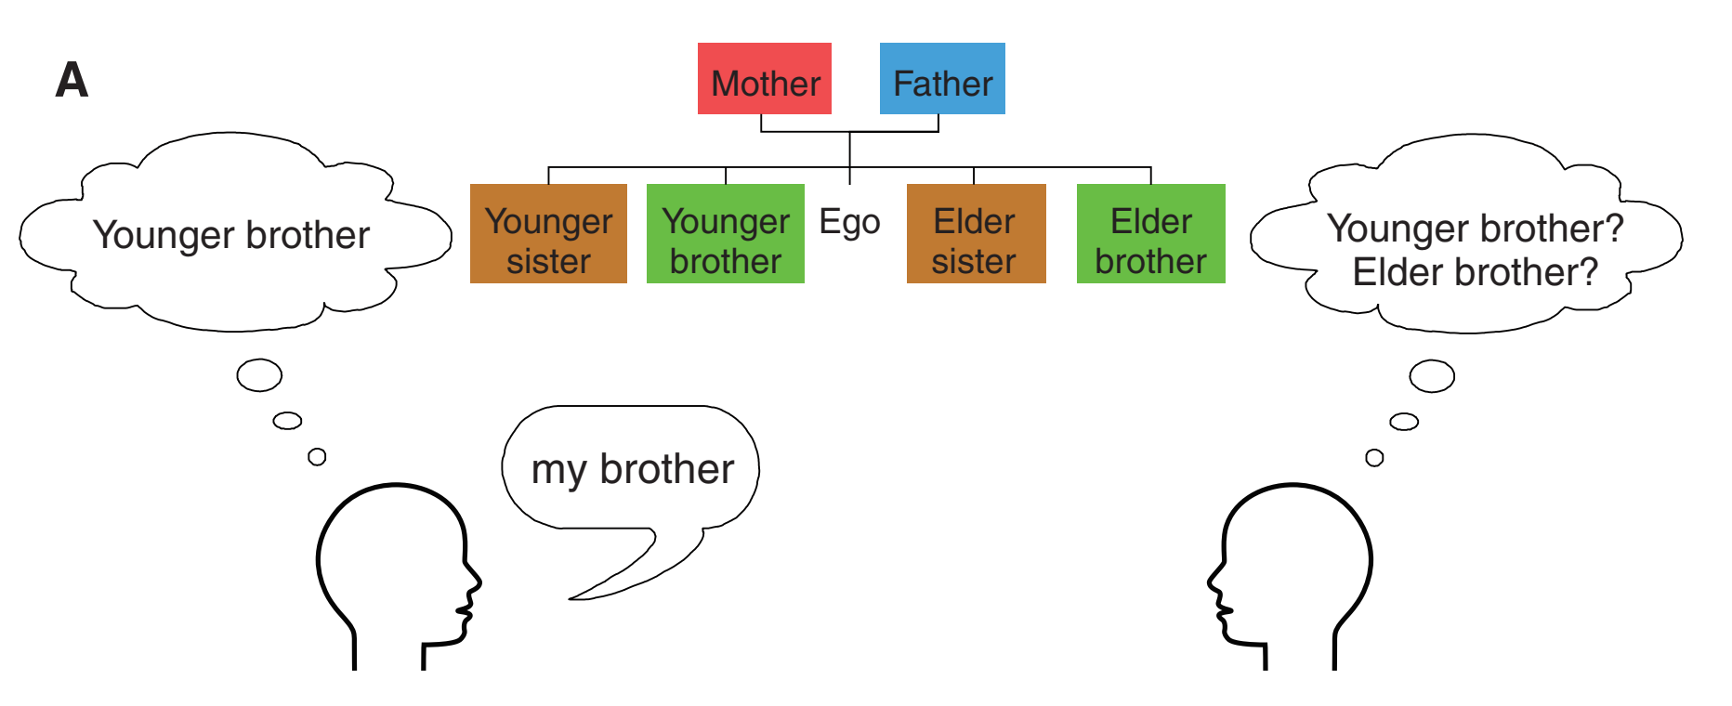
Modelling communication
Communicative cost of a system is the expected information-theoretic cost

Slide 9
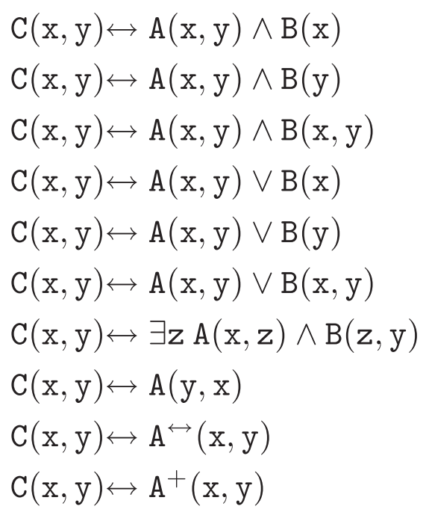
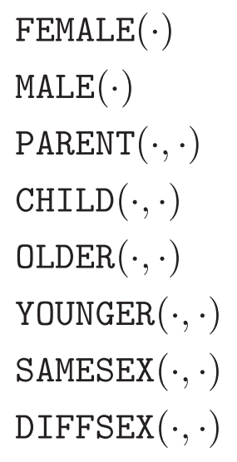
Modelling simplicity
We need:
A semantic space
A language to describe it
Find the MDL in the language of each category
The complexity of a system is the smallest number of rules needed to define all terms in the system.

Slide 10
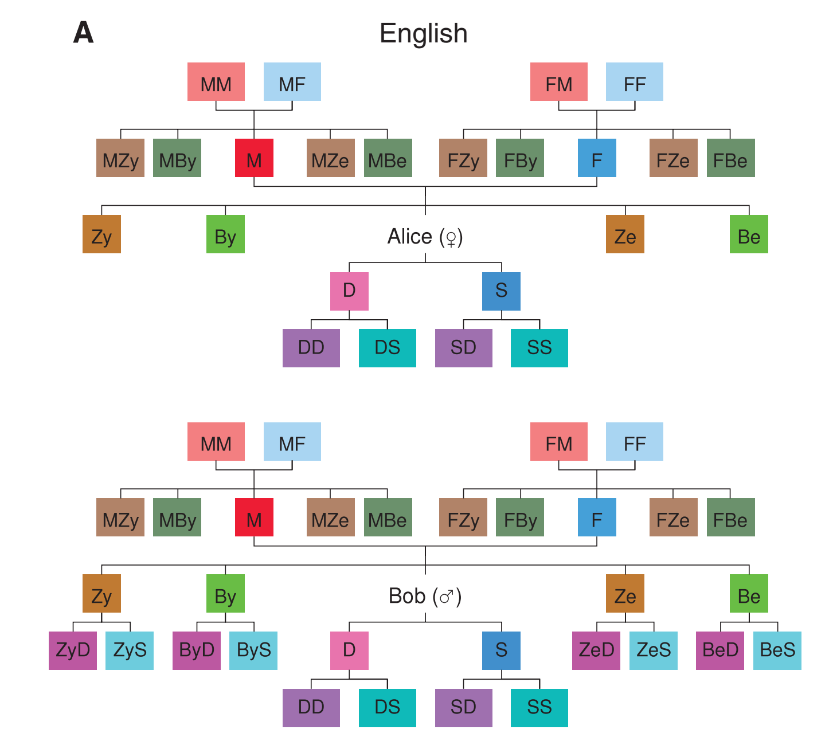
An example

Slide 11
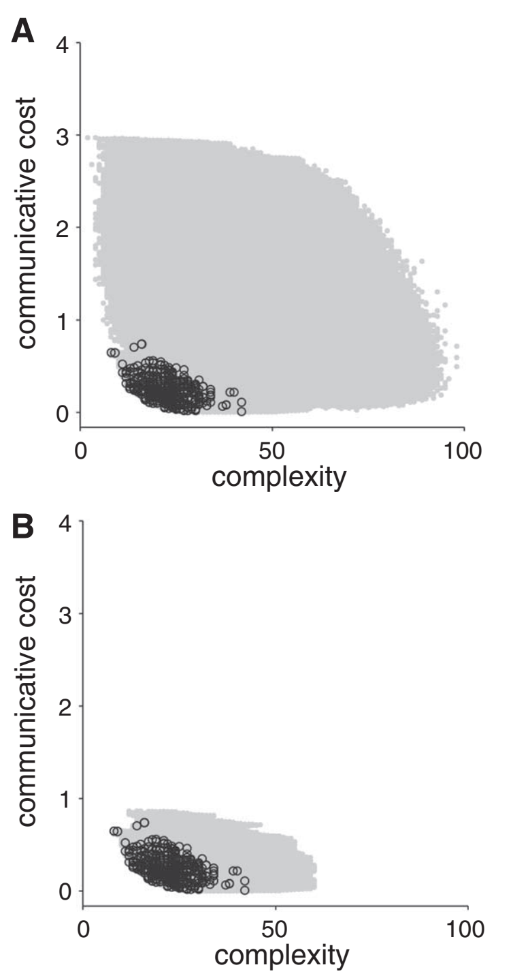
Lexicalized systems
All systems
Systems built from attested categories that appear more than twice in the Murdock data.

Slide 12
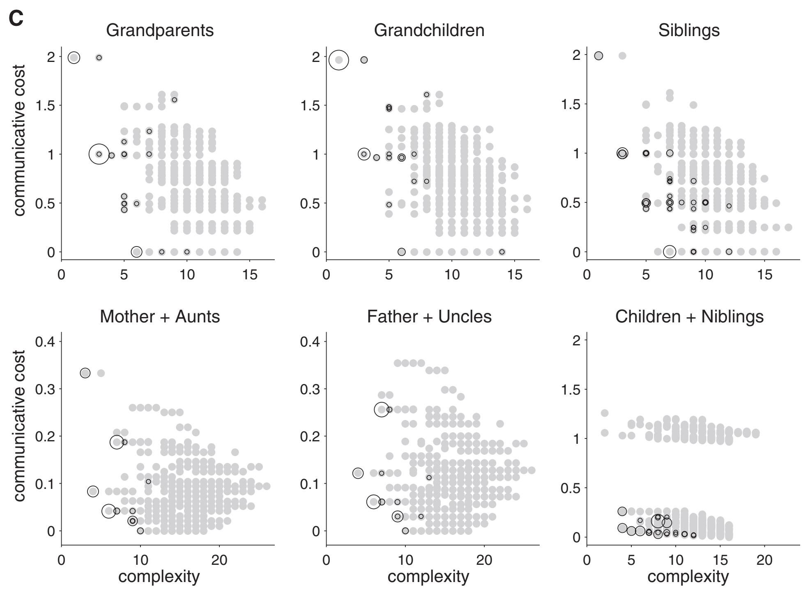
Optimality analysis
Black circles are attested
Size proportional to frequency (Murdoch)

Slide 13
Case Study II: Indefinite pronouns

Slide 14
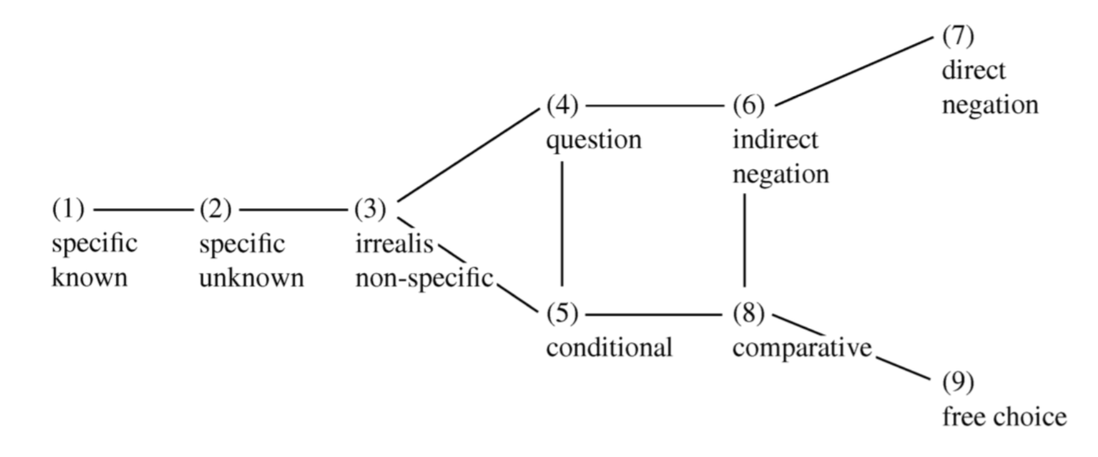
Indefinite pronouns
Denic, Steinert-Threlkeld, & Szymanik (2020)
Words like someone, something, anyone, anything, no-one, nothing
Haspelmath (2001):
Universal: Any indefinite pronoun in any language can only take functions which form a connected area on the map

Slide 15
Six types of indefinite pronouns
Specific known flavor [specific individual that the interlocutors can uniquely identify]:
Someone managed to mess this up — we all know who!
Specific unknown flavor [specific individual that the interlocutors cannot uniquely identify]:
I heard that someone failed, but I don’t know who.
Non-specific flavor [existential quantifier over some domain of possible referents]:
You should probably talk to someone else about this too.
Negative polarity flavor [existential quantifier over a widened domain of possible referents]:
Less than three companies hired anyone this year.
Free choice flavor [a wide-scope universal quantifier over some domain of possible referents]:
You can hire almost anyone here: most of them great.
Negative indefinite flavor [a negated existential quantifier over domain of possible referents]:
Who went to the party? No one.

Slide 16
Complexity
Semantic features (binary):
Known to the speaker (K)
Specific (S)
Scalar endpoint (SE)
Negative polarity and free choice indefinites evoke a pragmatic scale of alternatives ordered by likelihood, and they associate with its lowest endpoint
SE+: negative polarity, free choice, negative indefinite
SE−: specific known, specific unknown, non-specific
Scale reversal (R)
Reverse the order of alternatives on the pragmatic scale
In the scope of negation (N)
Complexity is the number of features an indefinite pronoun has
E.g., specific unknown flavor is ‘S+\ K−’
Complexity of 2

Slide 17
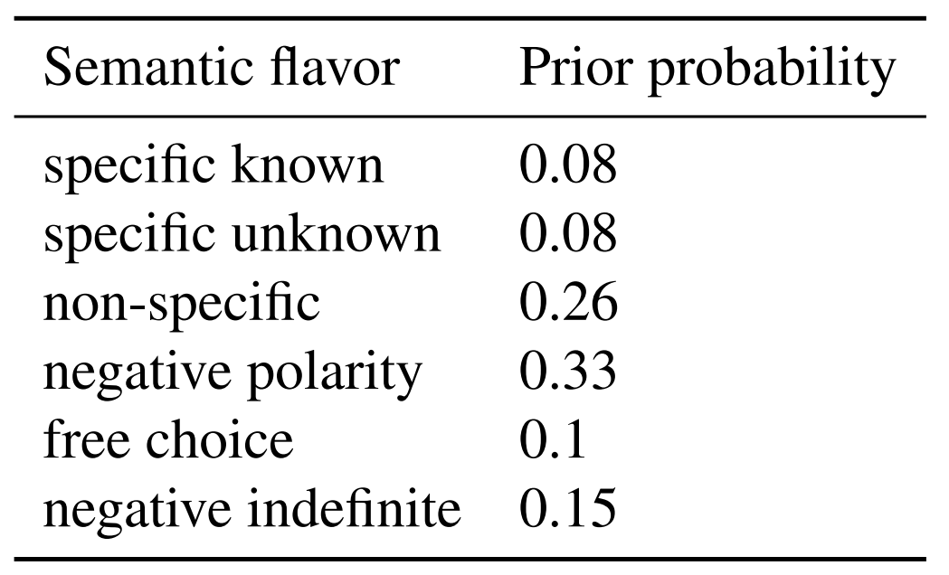
Informativeness
Probability that the communication will be successful given
The prior over flavors from the set of flavors
The conditional probability which reflects the probability that the speaker uses the indefinite pronoun i to communicate f
The probability that the listener correctly guesses f upon hearing i
Corpus estimate for flavour prior probability:

Slide 18
Some detail (can skip!)
Complexity and communicative cost measures for each of the 40 languages in Haspelmath’s corpus.
We artificially generated 10000 languages, which could have between 1 and 7 indefinite pronouns (7 is the maximum number of indefinite pronouns that any natural language has in Haspelmath’s corpus).
Each indefinite pronoun in each artificial language was randomly assigned one of the 63 logically possible combinations of flavors (26 −1 combination whereby an indefinite pronoun doesn’t convey any of the 6 flavors).
The artificial languages were then matched to natural languages for the degree of synonymy. The degree of synonymy captures how many different indefinites can be used to express a flavor: if the indefinites in a language have more overlapping meanings, the degree will be higher.
Matching ensured that for each degree of synonymy d of natural languages, the proportion of artificial languages with d was the same as the proportion of natural languages with d. After matching, 2133 artificial languages remained for comparison to natural languages (mean degree of synonymy in both groups is 0.67)

Slide 19
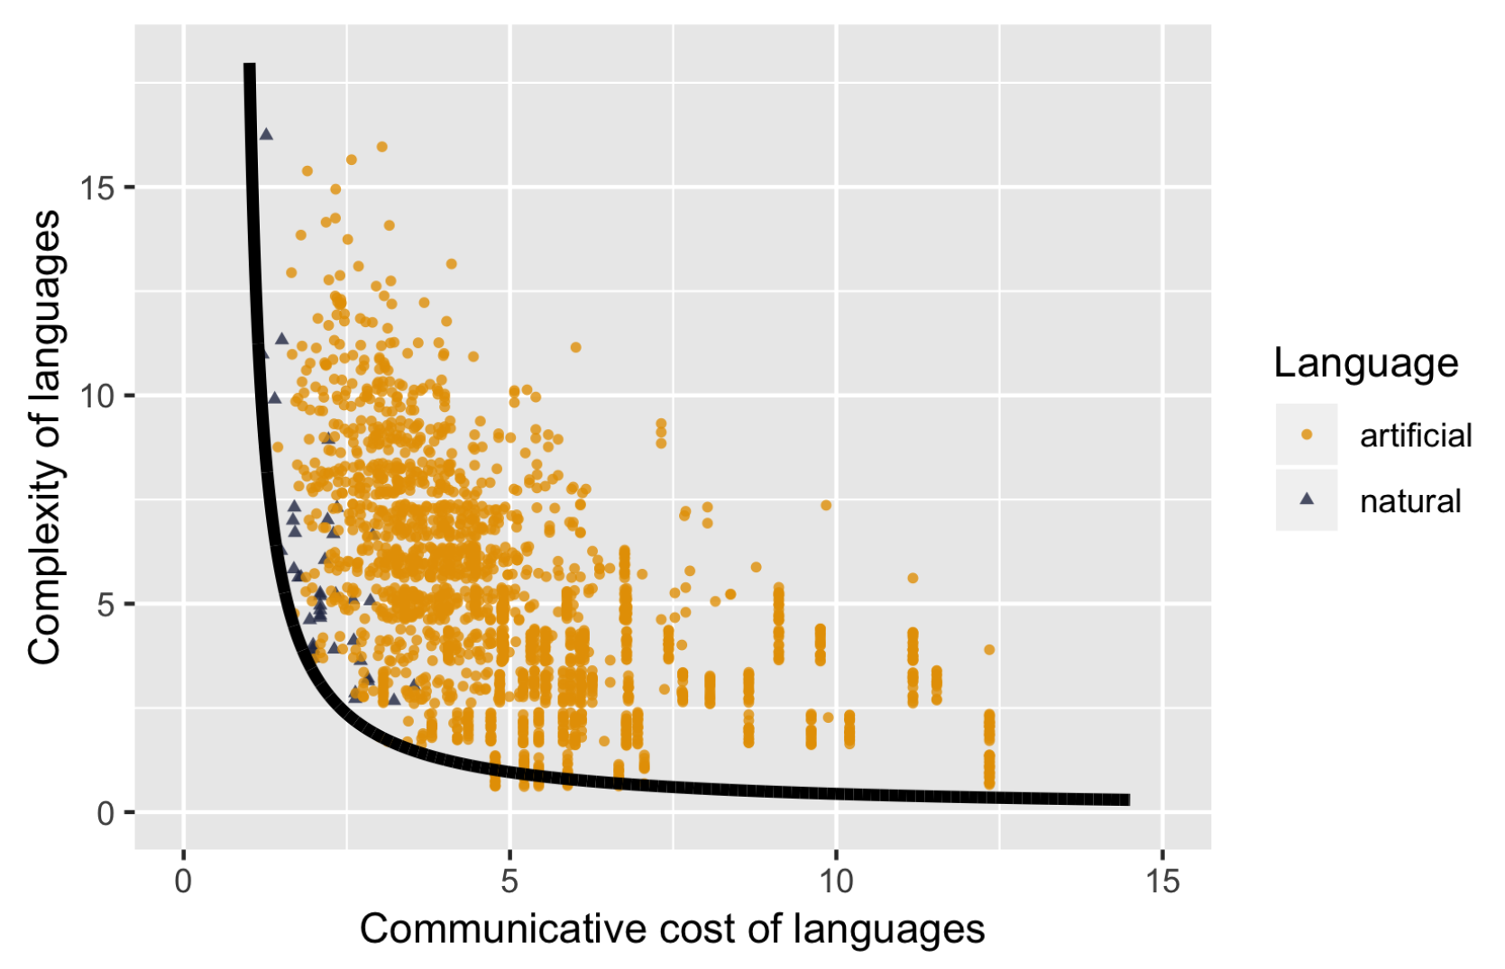
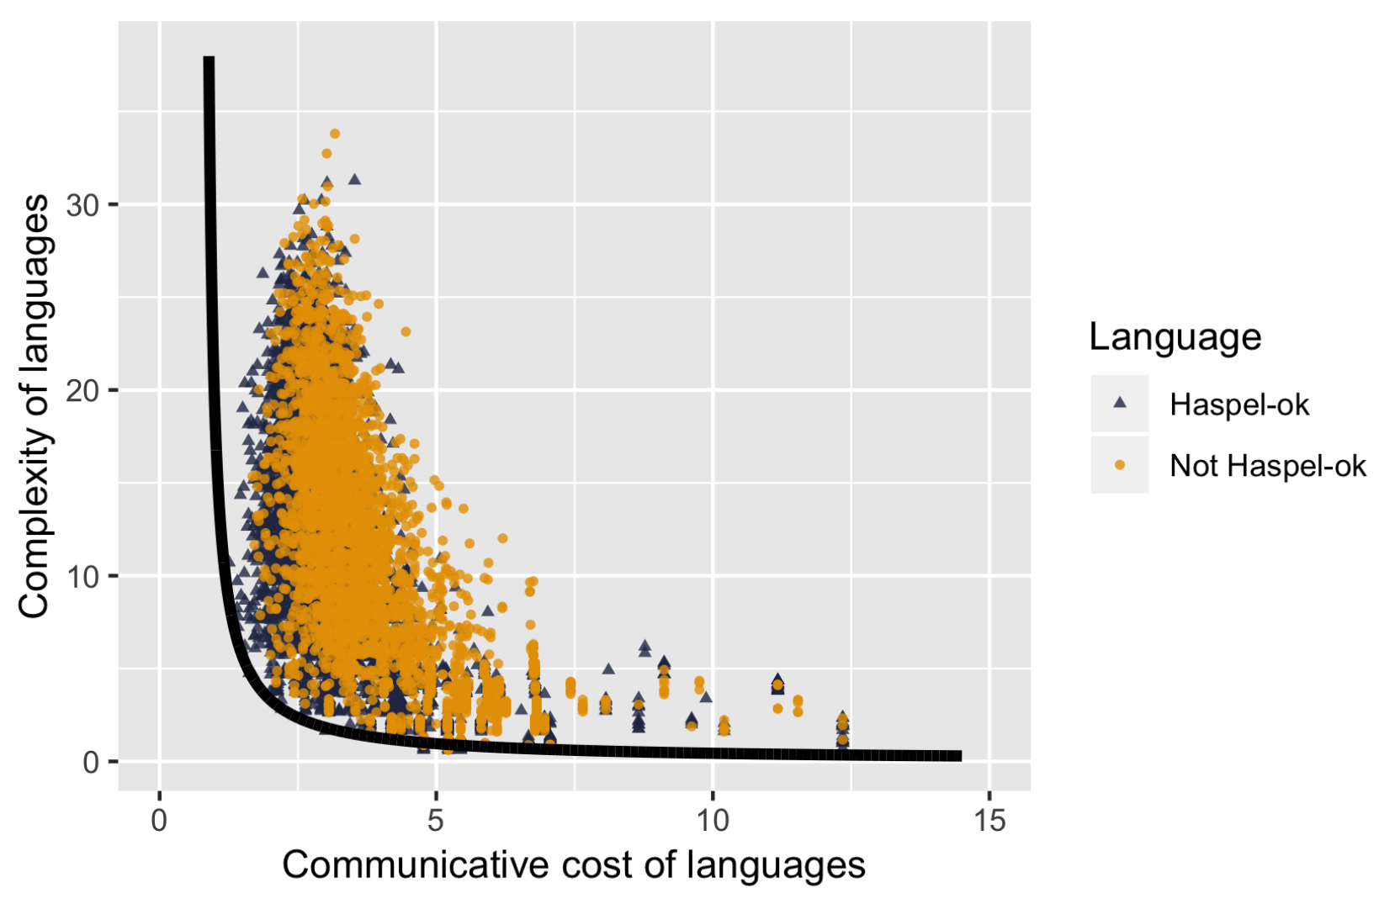
Results

Slide 20
Case Study III: Boolean universals

Slide 21
Boolean universals
Model in Uegaki (2021)
One universal: the absence of a term expressing the negation of the conjunction among attested Boolean connectives.
Other universal: specific attested inventories of operators.
Let’s try and see if (all and only) attested inventories lie at the Pareto frontier of simplicity and communicative accuracy.

Slide 22
The set of possibilities
Set of inventories is the powerset (minus the empty set) of the set of 16 binary Boolean operators (65535)
We consider strengthened meanings (with EXH)
{and,or}
{and,P,Q}
{and,or,xor}
{and,or,nor}
{and,nand, nor}

Slide 23
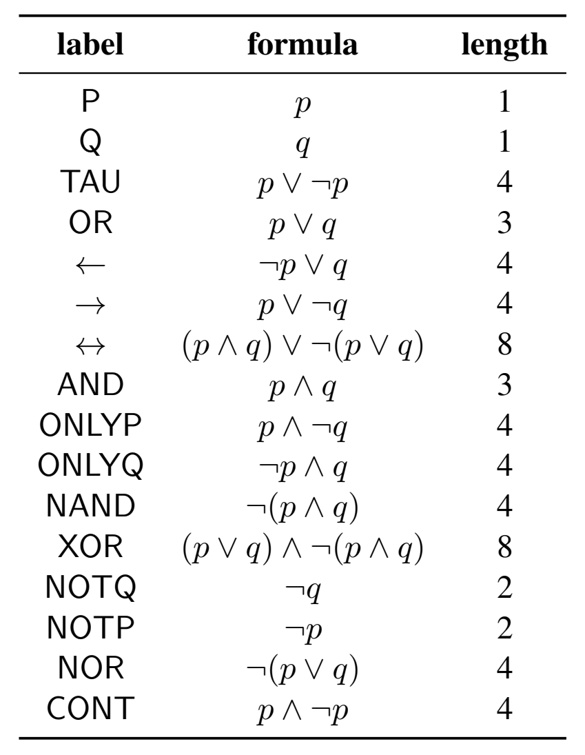
Complexity
The meaning of each operator can be encoded in propositional logic with negation, conjunction, and disjunction.
Complexity: the sum of the number of symbols in Propositional Logic containing ¬, ∧, and ∨ necessary to represent all connectives in the inventory.
Why this choice of logic
Circular?

Slide 24
Informativeness
Informativeness: the likelihood that the meaning intended by the sender is accurately recovered by the addressee, given scalar implicature
Utility is binary: 1 if intended message is recovered and 0 otherwise
 | W1 (p q) | W2 (p not-q) | W3 (not-q p) | W4 (not-p not-q) | Total
AND, OR | 1 (AND) | ½ (OR) | ½ (OR) | 0 (None) | 0.5
AND, P, Q | 1 (AND) | 1 (P) | 1 (Q) | 0 (None) | 0.75
AND, OR, XOR | ½ 1 (AND) + ½ 1/3 (OR) = 2/3 | 1/3 (OR) | 1/3 (OR) | 0 (None) | 0.375

Slide 25
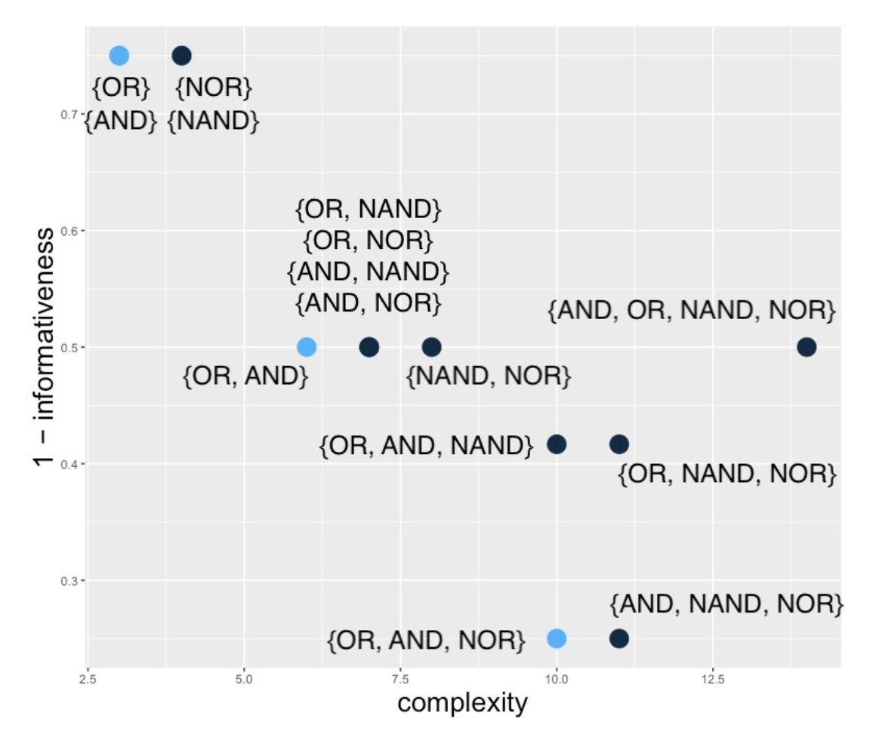
Four-corner inventories
Let’s start with just the four Aristotelian operators OR, AND, NOR, NAND.
All and only the typologically attested inventories are Pareto-optimal!
Can we include all operators?

Slide 26
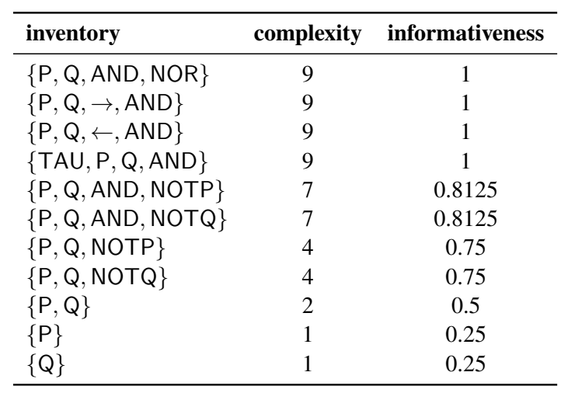
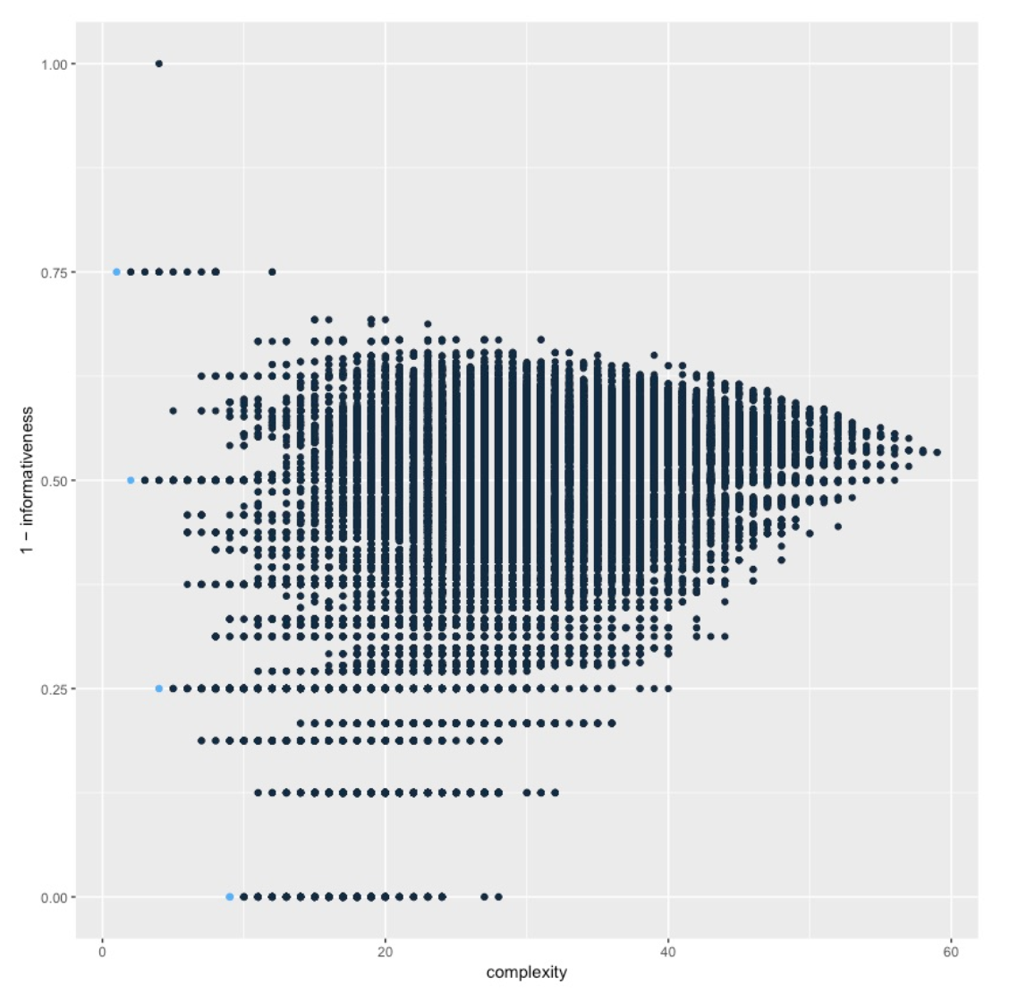
All inventories
No ‘or’ in Pareto frontier
Unattested inventories
Bad situation!

Slide 27
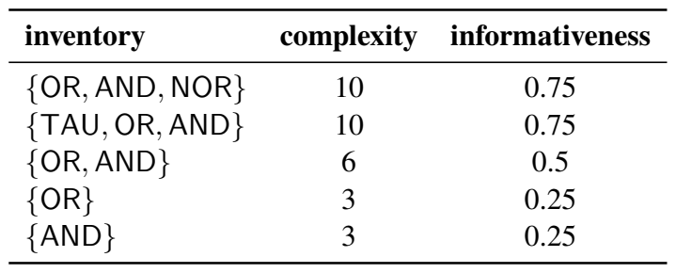
All inventories
Natural restriction: Commutative operators!
Operator O is commutative iff $O(x,y)=O(y,x)$
Non commutative: P, Q, NOTP, NOTQ, →, ←, ONLYP, ONLYQ
Commutative: TAU, CONT, OR, ↔, AND, NAND, XOR, NOR
Previous work: only commutative operators are lexicalizable (Gazdar and Pullum 1976; Gazdar, 1979: 74-78)
No clear explanation yet!
Only {TAU, OR, AND} is not attested
Independent work shows that trivial meanings are ungrammatical
(Barwise and Cooper, 1981; von Fintel, 1993; Gajewski, 2002; Fox and Hackl, 2007; Chierchia, 2013; Del Pinal, 2019)

Slide 28
Case Study IV: Adjectival monotonicity

Slide 29
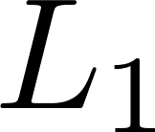
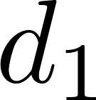
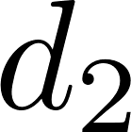
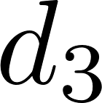
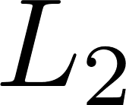
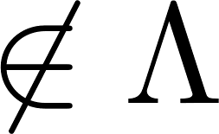
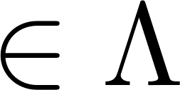
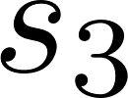
Modelling systems of gradable adjectives
 | 1 | 1 | 0
 | 0 | 1 | 0
 | 1 | 0 | 0
 | 1 | 1 | 0
 | 0 | 1 | 0
 | 0 | 1 | 1
Call a language “monotonic” iff all its meanings are monotonic

Slide 30
Prior over languages
Prior:
Step coding:
Monotonic
Non-monotonic
 | 1 | 1 | 0
 | 0 | 1 | 0
 | 0 | 1 | 1
1 bit
+ log(2) bits
<
1 bit
+ 2 * log(2) bits
1 | 1 | 0
0 | 1 | 0
Monotonic meanings get greater prior
probability than non-monotonic ones

Slide 31
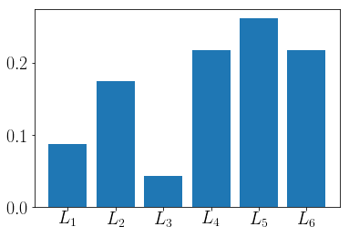
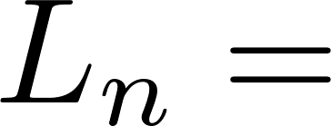
Learning
 | 1 | 0 | 0
 | 1 | 1 | 0
 | 0 | 1 | 1
 | 1
 |  | 1
 |  | 1
sample agents
Cultural parent
(Gen n)
Cultural child
(Gen n+1)

Slide 32
Overall IL model
Burn-in
Chain #
1
GEN 1
GEN 2
GEN h
GEN n-1
GEN n
2
GEN 1
GEN 2
GEN h
GEN n-1
GEN n
k
GEN 1
GEN 2
GEN h
GEN n-1
GEN n
Frequency of languages spoken

Slide 33
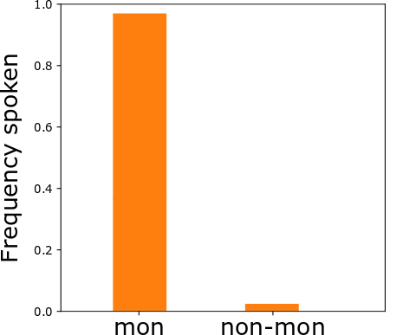
First model: IL with gradable adjectives
3000 generations of IL
100 agents
100 runs of the simulation
Burn-in: 500 generations
There is a problem…

Slide 34
Degeneracy
 | 1 | 0 | 1
 | 0 | 1 | 0
 | 0 | 1 | 1
 | 0 | 1 | 0
 | 0 | 1 | 1
 | 1 | 0 | 0
Non-degenerate
languages
 | 1 | 1 | 1
 | 0 | 0 | 0
 | 1 | 1 | 1
 | 0 | 0 | 0
 | 1 | 1 | 1
 | 0 | 0 | 0
Degenerate
languages

Slide 35
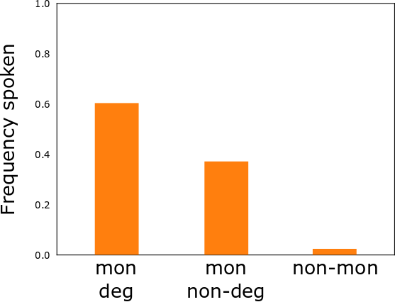
First model: IL with gradable adjectives
Not quite right!

Slide 36
A functional explanation
Monotone is cognitively simple
Iterated learning
standard is monotonic
non-degenerate
Degenerate is uninformative
Pressure for communicative accuracy
Notes:
I have shown that there is an interesting difference between nouns and gradable adjectives in terms of their extensions in the conceptual spaces. Nouns are merely convex, while gradable adjectives are monotonic.
I went over an explanation of the convexity of nouns: nouns are convex because convex extensions are the simplest to encode with the descriptive resources given by nominal conceptual spaces
I proposed that we should look for an explanation for the monotonicity of gradable adjectives that’s similar to the explanation of convexity for nouns, since the two phenomena are very similar
Since the explanation for the convexity of nouns depends on the structure of nominal spaces, I proposed a structure for adjectival conceptual spaces.

Slide 37
Second model: communication
 | 1 | 0 | 0
 | 0 | 1 | 0
 | 0 | 1 | 1
 | 1 |  | 0
 |  | 1 | 0
 |  | 1
 | 1 | 0 | 0
 | 0 | 1 | 0
 | 0 | 1 | 1
 | 1 | 0 | 0
 | 1 | 1 | 0
 | 0 | 1 | 1
 | 1 | 0 | 0
 | 1 | 0.5 | 0
 | 0 | 0.5 | 1
 | 1 |  | 0
 |  | 1 | 0
 |  | 1
 | 1 |  | 0
 |  | 1 | 0
 |  | 1
 | 1 | 0 | 0
 | 0 | 1 | 0
 | 0 | 1 | 1
 | 1 | 0 | 0
 | 1 | 1 | 0
 | 0 | 1 | 1
 | 1 | 0 | 0
 | 1 | 0.5 | 0
 | 0 | 0.5 | 1
 | 1 |  | 0
 |  | 1 | 0
 |  | 1
Speaker
Hearer
Notes:
The first model failed. However, this line of explanation is very intuitive, so I think it makes sense to explore it further. I consider additional pressures that might be shaping the semantics of scalar language.
Besides simplicity, the most important pressure is communicative efficiency, defined as the probability that the hearer will understand what the speaker means after the speaker has observed how the world is.
What this probability is will depend on how the speaker picks a signal given an observation and how a hearer picks a meaning given a signal. Present model of literal communication.
This is prima facie a promising approach because intuitively the problem with degenerate meanings is that they are communicatively bad.

Slide 38
Second model: communication
Success!
 | 1 | 0 | 0
 | 1 | 0.5 | 0
 | 0 | 0.5 | 1
 | 1 | 0 | 0
 | 0 | 1 | 0
 | 0 | 1 | 1
Speaker
Hearer
Notes:
The first model failed. However, this line of explanation is very intuitive, so I think it makes sense to explore it further. I consider additional pressures that might be shaping the semantics of scalar language.
Besides simplicity, the most important pressure is communicative efficiency, defined as the probability that the hearer will understand what the speaker means after the speaker has observed how the world is.
What this probability is will depend on how the speaker picks a signal given an observation and how a hearer picks a meaning given a signal. Present model of literal communication.
This is prima facie a promising approach because intuitively the problem with degenerate meanings is that they are communicatively bad.

Slide 39
Second model: communicative pressure
(Uniform probability of observing degrees)
Expected communicative accuracy:
Probability that the speaker uses that signal for that degree
Probability that the listener guesses that degree for that signal
Notes:
The first model failed. However, this line of explanation is very intuitive, so I think it makes sense to explore it further. I consider additional pressures that might be shaping the semantics of scalar language.
Besides simplicity, the most important pressure is communicative efficiency, defined as the probability that the hearer will understand what the speaker means after the speaker has observed how the world is.
What this probability is will depend on how the speaker picks a signal given an observation and how a hearer picks a meaning given a signal. Present model of literal communication.
This is prima facie a promising approach because intuitively the problem with degenerate meanings is that they are communicatively bad.

Slide 40
Implementing communicative pressure
GEN n-1
GEN n
0.70
0.80
0.65
0.70
0.74

Slide 41
Implementing communicative pressure
GEN n-1
GEN n
GEN n+1
0.19
0.22
0.18
0.19
0.20

Slide 42
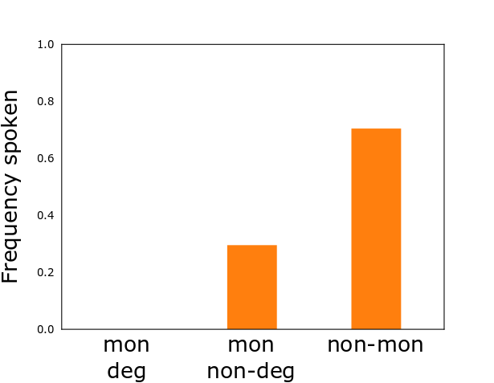
Results of second model
3000 generations of IL
100 agents
100 runs of the simulation
Burn-in: 500 generations
Incorrect prediction!
Notes:
(Present the results)
The second proposal overshoots, so to speak. The languages jump the monotonic phase and directly become non-monotonic.
On a moment’s reflection, this makes sense. Any overlap between meanings is going to reduce the communicative accuracy of the language, and having three monotonic extensions necessarily implies overlap to some extent.
However, especially when scalar language is involved, the way communication was modelled in the second model is inadequate.
When scalar language is involved, pragmatic skills (scalar implicatures) influence how speakers pick a signal and how hearers interpret it in very important ways.

Slide 43
Why non-monotonic?
Scale
Signal 1
Signal 2
Signal 3
Notes:
Given three monotonic signals, at least two overlap
Given the way we defined communicative accuracy, a completely monotonic language cannot be optimal
The problem is that agents produce and understand just using the literal meanings in their language. But we know that is not how humans use scalar expressions.
Therefore, we can try and implement more sophisticated behaviour

Slide 44
A bit of pragmatics: scalar implicatures
°C
°C
Warm
Warm
Hot
Hot
If it had been greater than , she would have said “hot”.
“Warm”
Speaker
Hearer
Notes:
We know that communication with scalar terms is not adequately modelled by the literal agents we implemented in the second model.

Slide 45
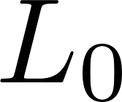
Modelling scalar implicatures
Given a signal, picks a degree
just based on the semantics
Given a degree, tends to pick the signal that maximises the probability that the literal hearer guesses that degree.
Given a signal, picks a degree under the assumption that the speaker is pragmatic
Literal
hearer
Pragmatic
speaker
Pragmatic
hearer
Model from Goodman & Frank (2016)
Notes:
We know that communication with scalar terms is not adequately modelled by the literal agents we implemented in the second model.

Slide 46
Modelling scalar implicatures
°C
Warm
Hot
Literal
hearer
Pragmatic
speaker
Pragmatic
hearer
Model from Goodman & Frank (2016)
Notes:
We know that communication with scalar terms is not adequately modelled by the literal agents we implemented in the second model.

Slide 47
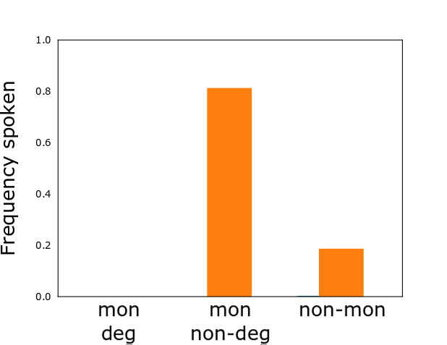
Results of third model
3000 generations of IL
100 agents
100 runs of the simulation
Burn-in: 500 generations
Monotonicity evolves!

Slide 48
Conclusion of modelling
Monotone is cognitively simple
Iterated learning
standard is monotonic
Pressure for communicative accuracy with pragmatic agents
non-degenerate
Degenerate is uninformative

Slide 49
A few final words
There is other work on tradeoff analyses
Quantifiers (Steinert-Threlkeld, 2021)
Color naming, folks biology, number systems (Kemp, Xu, Regier 2018)
Modal semantics (Imel & Steinert-Threlkeld, 2022)
Considering multiple pressures at once most promising explanation
Many open questions in how to explain universals. Methods we’ve seen:
Learnability (ANNs, Bayesian pLoT, MDL)
Complexity (logical, Kolmogorov)
Cultural evolution (iterated learning)
Combination of pressures (tradeoff analysis, IL+communication)
Many exciting avenues for future work!

