Slide 1
Computational approaches
to the explanation
of universal properties of meaning
Fausto Carcassi & Jakub Szymanik
https://thelogicalgrammar.github.io/ESSLLI22_langevo

Slide 2
Recap
Learnability can explain the presence of universals.
But is it the only (or the best) such explanation?
A natural idea: some notion of complexity explains both the universals and the learnability facts.
Notes:
Structure

Slide 3
What’s the right measure of complexity?
Previous attempts fail to capture the distinctions:
Automata theory (van Benthem 1986)
Computational complexity (Szymanik 2016)
Formal learning theory (Tiede 1999; Gierasimczuk 2007; Gierasimczuk 2009a)
Let’s try a philosophical idea!
Notes:
Structure

Slide 4
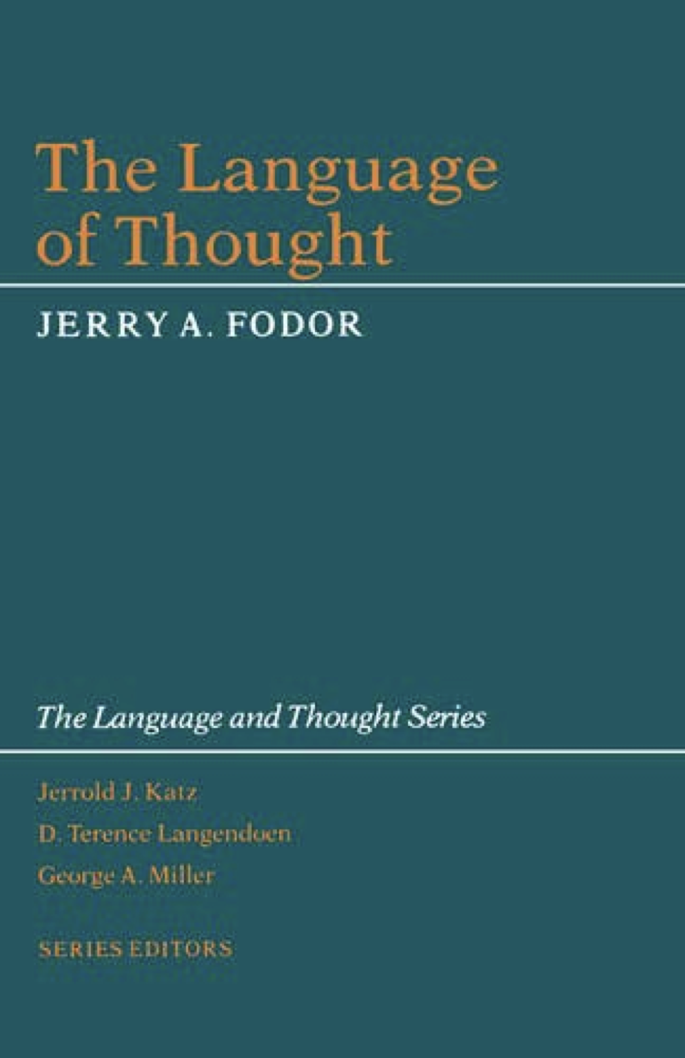
The Language of Thought Hypothesis is the hypothesis that thinking happens in a mental language, the Language of Thought.
Generally assumed to look somewhat like a logic: predicates get combined with logical operators.
Modern version popularised by Jerry Fodor.
The classical picture of LoTs that philosophers developed is meant to be an account of thinking, explaining phenomena such as learning from few examples, decision-making, perception, etc.

Slide 5
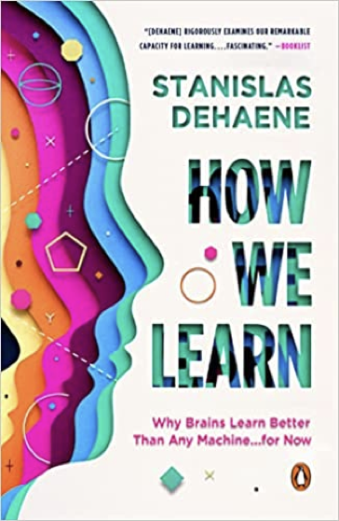
Leibniz, 1677, Boole, 1854, Fodor, 1975,…, Rescorla, 2019, and others
Recently, revived interest in cognitive science:
Feldman, 2003, Tenenbaum and Griffiths, 2001, Tenenbaum and Xu, 2007, Piantadosi, 2016, etc.
Perhaps a missing peace to make AI more human-like

Slide 6
Boolean Categorization

Slide 7
Boolean relations are a way to create new concepts:
`cousin’ is a child of an uncle or aunt
‘beer’ is an alcoholic beverage usually made from malted cereal grain and flavored with hops, and brewed by slow fermentation
in basketball, `travel’ is illegally moving the pivot foot or taking three or more steps without dribbling
`depression’ is a mood disorder characterized by persistent sadness and anxiety, or feeling of hopelessness and pessimism, or …

Slide 8
How people acquire, represent, and use concepts?
E.g., concepts depending on and are easier to learn than those depending on or (Bruner et al. `65).
But the data seems more puzzling (see next slide).
What’s the logical theory of complexity here?

Slide 9
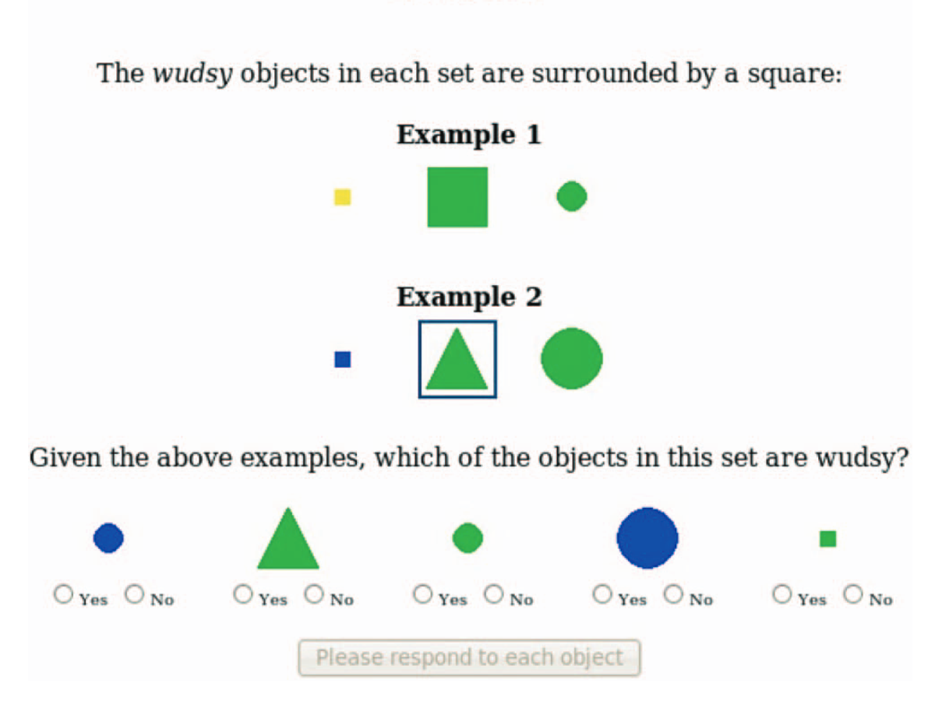
Piantadosi et al. 2016

Slide 10
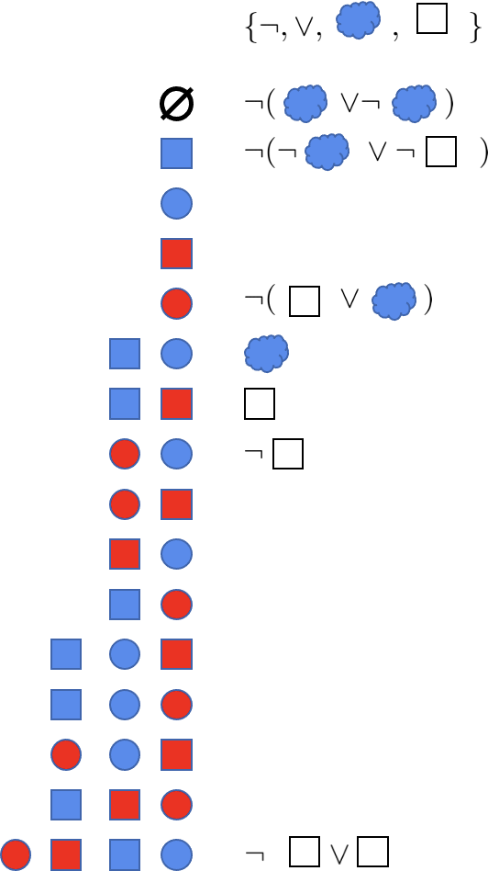
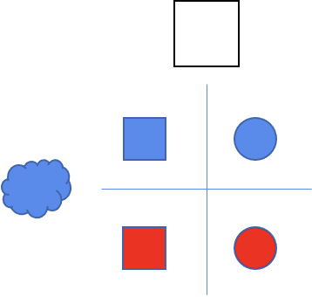

Slide 11
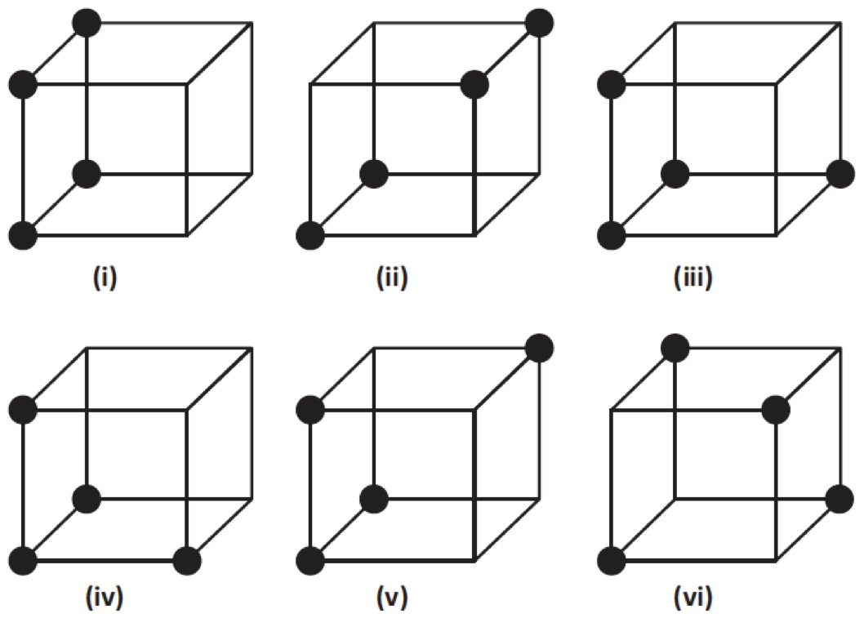
Shepard’s trend
Six different sorts of concept based on three binary variables
Each concept: 4 instances and 4 non-instances in 8 possibilities
Different presentations methods: sequentially, simultaneously, etc.
Dependent variables: errors, latencies, accuracy of descriptions, etc.
I < II < III, IV, V < VI
Shepard et al.’61
Notes:
Structure

Slide 12
The instances of the concepts
Concept number | Instances
I | not-a b c not-a b not-c not-a not-b c not-a not-b not-c
II | a b c a b not-c not-a not-b c not-a not-b not-c
III | a not-b c not-a b not-c not-a not-b c not-a not-b not-c
IV | a not-b not-c not-a b not-c not-a not-b c not-a not-b not-c
V | a b c not-a b not-c not-a not-b c not-a not-b not-c
VI | a b not-c a not-b c not-a b c not-a not-b not-c
Notes:
Structure

Slide 13
Boolean Complexity
The length of the shortest Boolean formula logically equivalent to the concept, e.g., expressed in terms of the number of literals (positive or negative variables).
Btw, finding the shortest formula is intractable.
(a and b) or (a and not b) or (not a and b) reduces to (a or b)
Notes:
Structure

Slide 14
BC captures the trend
Concept number | Instances | Minimal description
I | not-a b c not-a b not-c not-a not-b c not-a not-b not-c | not a (1)
II | a b c a b not-c not-a not-b c not-a not-b not-c | (a and b) or (not a and not b) (4)
III | a not-b c not-a b not-c not-a not-b c not-a not-b not-c | (not a and not c) or (not b and c) (4)
IV | a not-b not-c not-a b not-c not-a not-b c not-a not-b not-c | (not c or (not a and not b)) and (not a or not b) (5)
V | a b c not-a b not-c not-a not-b c not-a not-b not-c | (not a and not (b and c)) or (a and (b and c)) (6)
VI | a b not-c a not-b c not-a b c not-a not-b not-c | (a and ((not b and c) or (b and not c))) or (not a and ((not b and not c) or (b and c))) (10)
Notes:
Structure

Slide 15
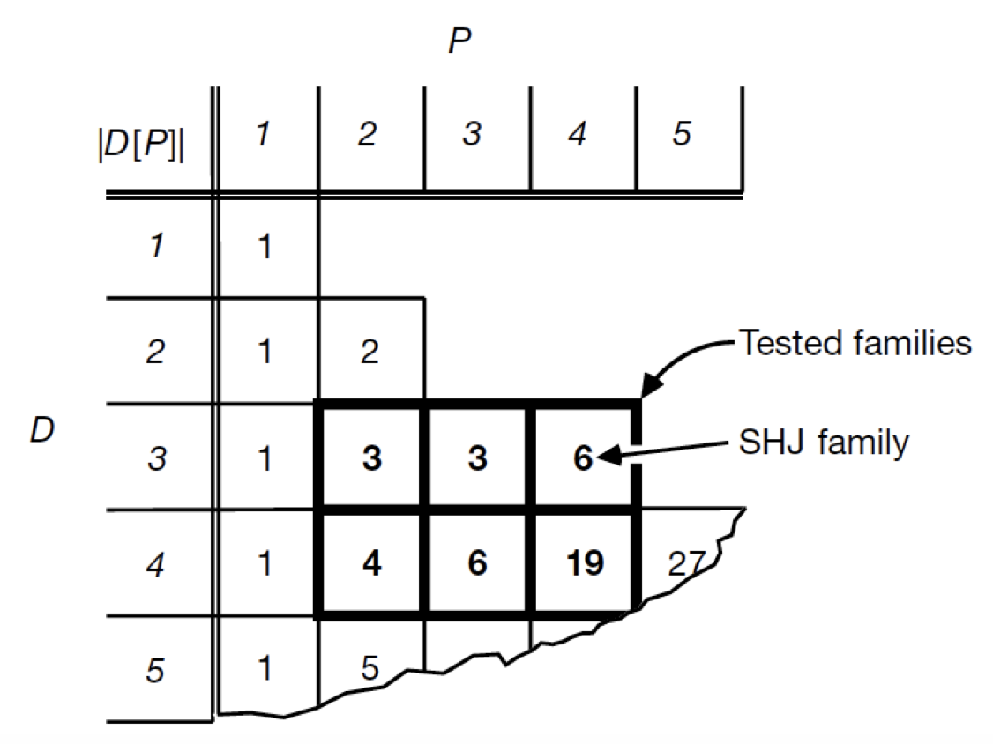
New Data Set
Consider an arbitrary Boolean concept defined by P positive examples over D binary features.
For Shepard types D=3 and P=4.
Feldman studies 76 Boolean concepts.
Feldman `01
Notes:
Structure

Slide 16
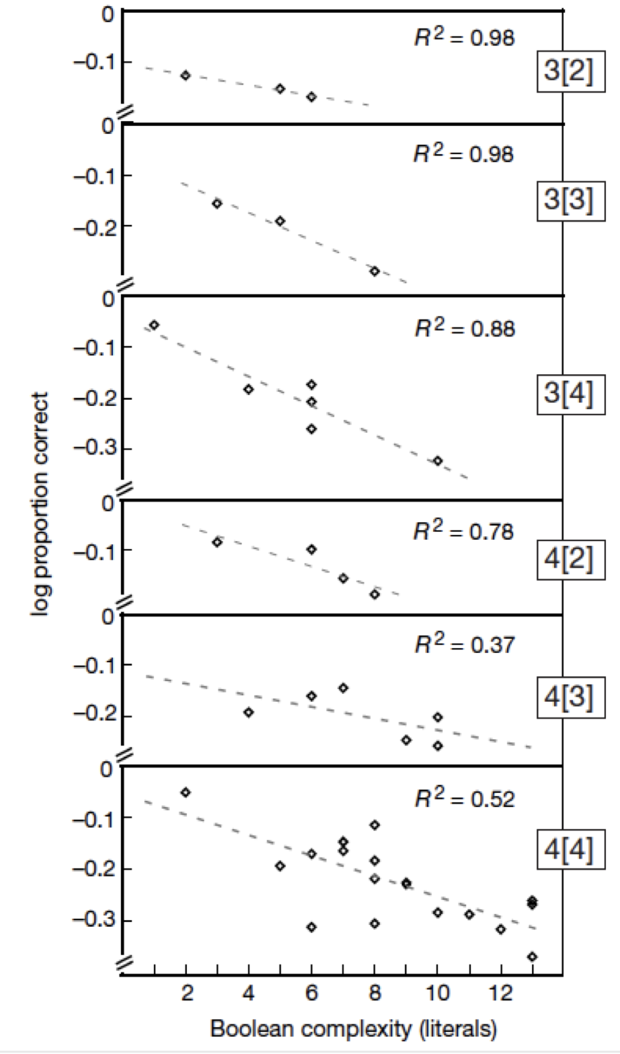

Slide 17
Simplicity: a unifying principle in cognitive science?
(Chater and Vitanyi, 2013), (Hsu, Chater, Vitanyi, 2013),…
MDL one of the ways to operationalize simplicity.
Other options: computational complexity (van Rooij, 2008, Szymanik, 2016), Kolmogorov complexity (see below), machine learning (cf. Carcassi & Szymanik, 2022)

Slide 18
Applying pure complexity idea to quantifier universals

Slide 19
We need a more expressive logical grammar
Notes:
Structure

Slide 20
We generate all expression of length up to 5 (or 7): solving the minimal pair problem
Length = the number of operators
The minimal expression length of Q is the length of the shortest expression for this quantifier.
At most 1 = (2>|A⋂B|) or ¬(|A⋂B|)>1
We generated ~25k unique quantifiers (up to model size 8)

Slide 21
van de Pol, Lodder, van Maanen, Steinert-Threlkeld, Szymanik. Quantifiers satisfying semantic universals have shorter minimal description length. Cognition 2022
Data and code: https://github.com/ivdpol/QuantifierComplexity
Notes:
A z-score is obtained by subtracting the mean and dividing by the standard deviation for each value of the variable. This results in a standardized variable, which is a variable rescaled to have a mean of 0 and a standard deviation of 1.

Slide 22
van de Pol, Lodder, van Maanen, Steinert-Threlkeld, Szymanik. Quantifiers satisfying semantic universals have shorter minimal description length. Cognition 2022
Data and code: https://github.com/ivdpol/QuantifierComplexity

Slide 23
van de Pol, Lodder, van Maanen, Steinert-Threlkeld, Szymanik. Quantifiers satisfying semantic universals have shorter minimal description length. Cognition 2022
Data and code: https://github.com/ivdpol/QuantifierComplexity
Notes:
In addition to considering the descriptive statistics, we performed logistic regressions for each universal property individually and for all properties taken together, with the universal property as dependent variable and complexity as the independent variable. The logistic regression model quantifies the relation between complexity and universal property, by estimating the probability that a quantifier satisfies a universal given the complexity of the quantifier. In the case of minimal expression length this means that the logistic regression model quantifies the relation between minimal expression length and universal property that is apparent from Figure 6. The regression coefficient β of the (standardized) complexity indicates that a change of 1 standard deviation in complexity is associated with a change of β in log odds of a quantifier satisfying a universal. We compare the coefficient value of complexity to the coefficient value of a random baseline, which we generate by randomly shuffling the actual complexity values over the different quantifiers and doing logistic regression over those randomly shuffled values. The coefficient value of the random baseline can be seen as quantifying the relation between a random property of the quantifiers and whether a quantifier satisfies a semantic universal. We compare the coefficient of the random baseline with the coefficient of complexity to see if complexity indeed has a different relation to the universal than a random property. We used bootstrap resampling to compute a distribution over the regression coefficient of complexity and of the random baseline.26 Note that we are not performing a significance test of a sample here, but rather aim to quantify the uncertainty of a difference in a whole population of simulated results. To achieve this, bootstrapping samples from that population, and comparing that to randomly labeled bootstrap samples (the random baseline) yields an estimate of the uncertainty around the regression coefficient, and whether this distribution of coefficients exceeds the distribution of coefficients observed by chance alone. We generated the distribution over the coefficient of the random baseline by randomly shuffling the actual complexity values over the different quantifiers, each time before taking a sample. We computed the coefficient of the original complexity data and of the random baseline in pairs, over the same random samples of quantifiers. To compare the coefficient of complexity to the coefficient of the random baseline, we plotted the distribution of the difference, per sample, between the coefficient of complexity and the coefficient of the random baseline. We report the mean of this distribution of the coefficient difference as a measure for the relation between complexity and universal property: if the mean is negative, that indicates that quantifiers satisfying the universal are indeed simpler

Slide 24
Meanings satisfying semantic universals are simpler
The setup avoids the minimal pair methodology
Is it robust wrt the chosen LoT?
So, which one is it: complexity or learnability?

Slide 25
Other measure of complexity

Slide 26
Approximate Kolmogorov Complexity
K(x)—the length of the shortest program p that outputs x
Language dependent but the effect is bounded (Invariance Theorem)
The drawback: K is uncomputable
LZ(x)—Lempel-Ziv is a tractable approximation of K
Recent applications: Dingle, Camargo, and Louis 2018; Feldman 2016; Valle-Pérez, Camargo, and Louis 2019

Slide 27
Lempel-Ziv algorithm
Loseless compression algorithm
Approximates K in the limit
# unique subpaterns of a string
A measure of structure
0|01|1|011|00|0110 = 6
1|11|111|1111|111 = 4

Slide 28
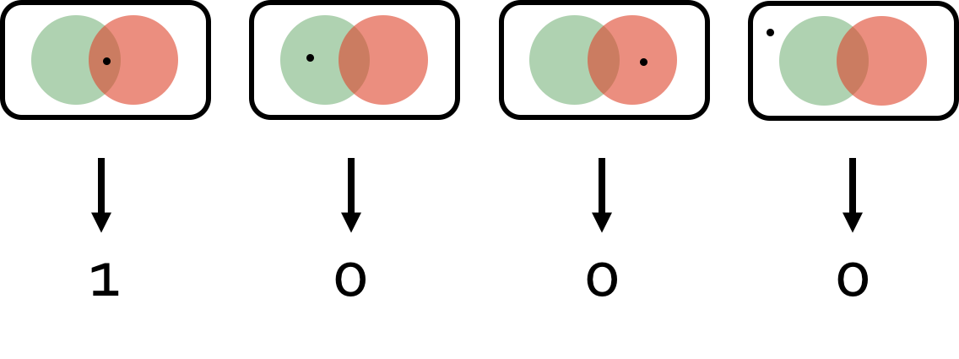
Idea: universals induce regularity/structure in the distribution of truth values across models, which aid compressibility.

Slide 31
LoT+learning
Why learnability as fencing-in fails
Piantadosi, Tannenbaum, Goodman, 2013

Slide 32
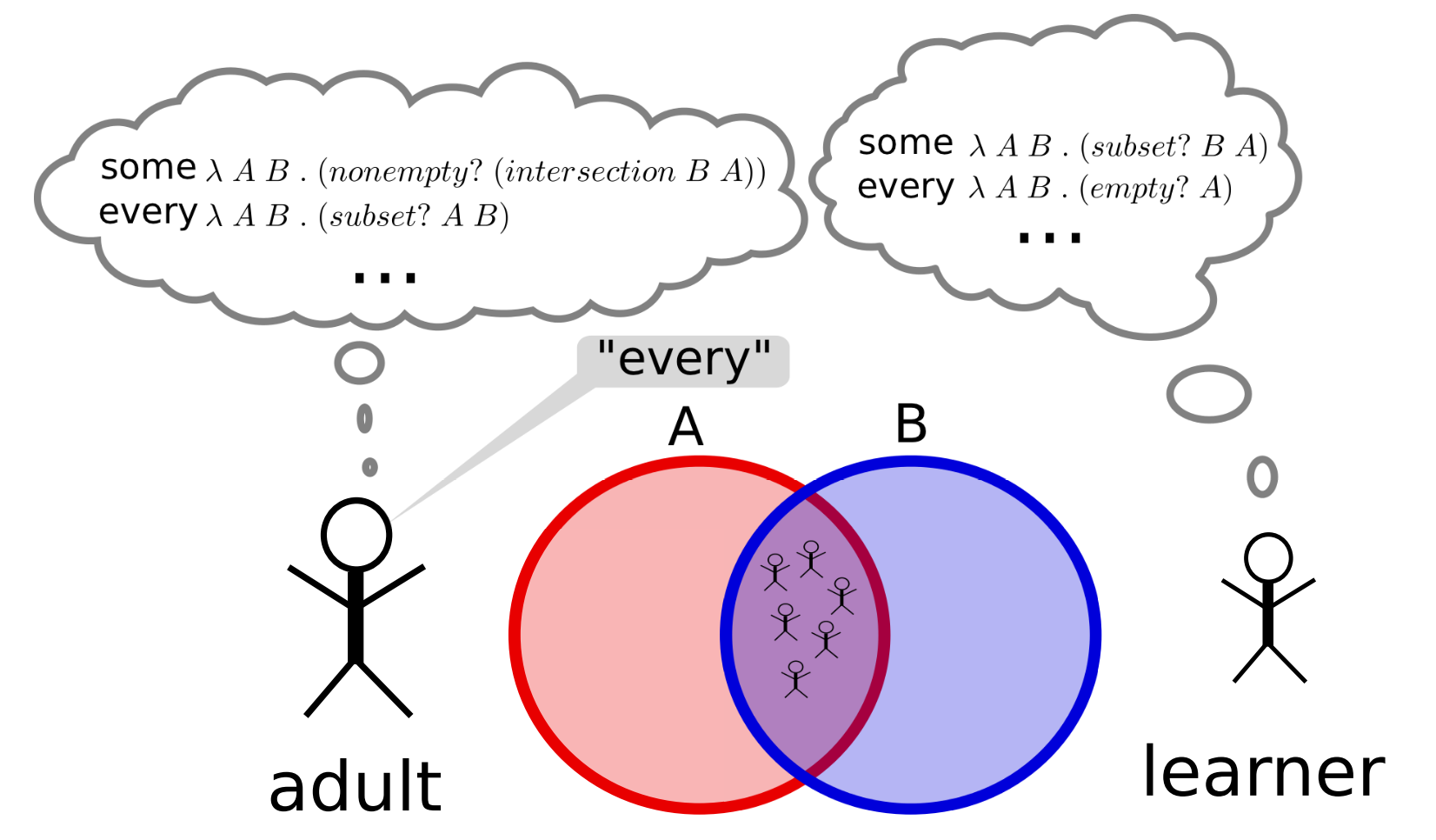

Slide 36
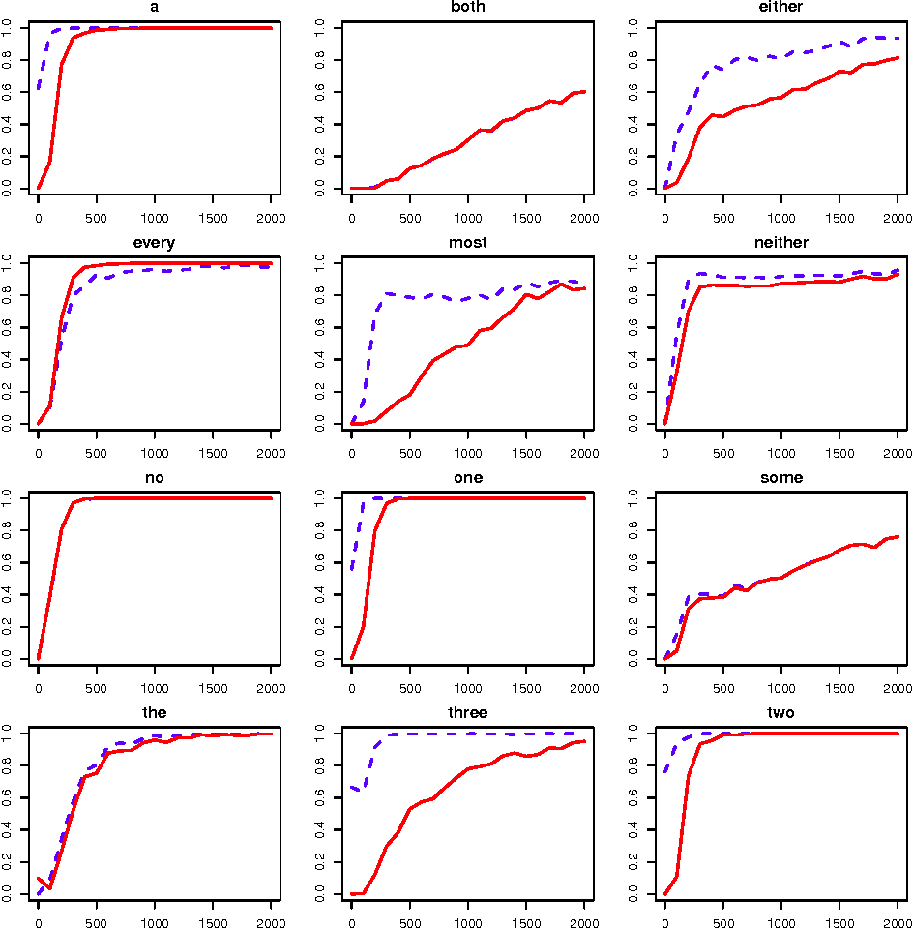

Slide 38
“Likely, the unrestricted space has many hypotheses which are so implausible, they can be ignored quickly and do not affect learning. The hard part of learning, may be choosing between the plausible competitor meanings, not in weeding out a large space of potential meanings.”

Slide 39
Does this model predict human learning curves well?
How sensitive are the model and its results sensitive to various choices (e.g. primitives, weights, shape of likelihood function)?
Does it say anything general about e.g. monotone and topic-neutral quantifiers?

Slide 40
Robustness of the results depending on the LoT

Slide 41
Which Boolean connectives?

Slide 42
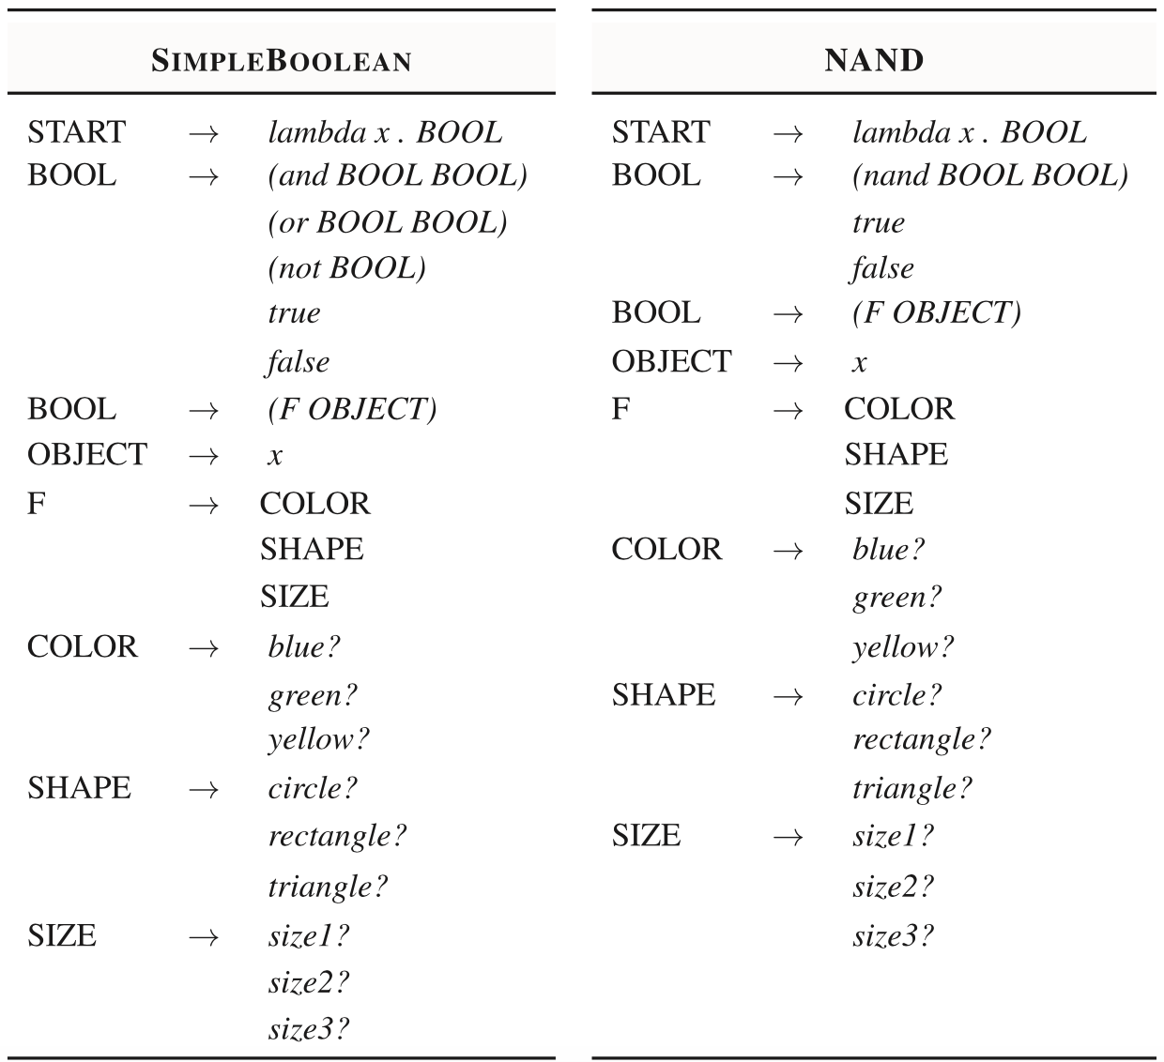

Slide 43
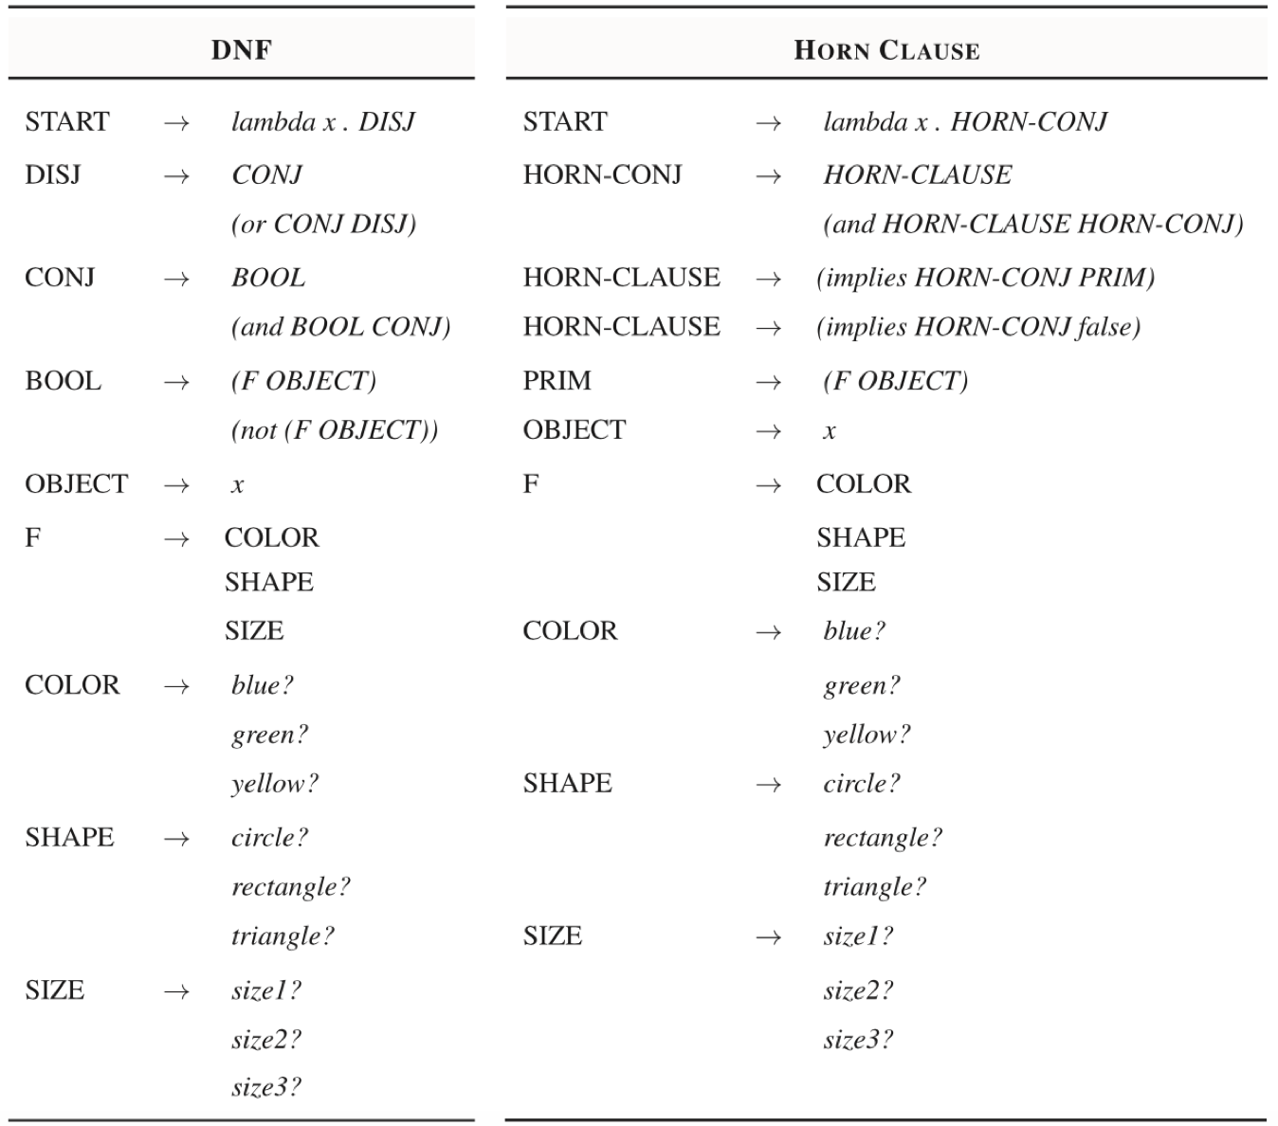

Slide 44
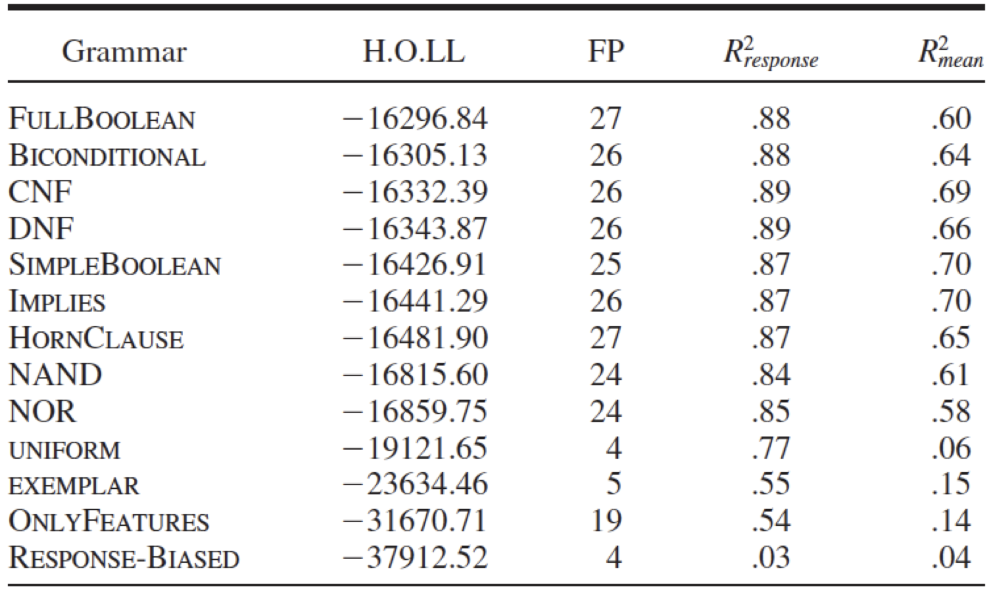
Which representational system is the most likely, given human responses?
Piantadosi et al. 2016

Slide 45
You can also infer LoT from the informativeness-complexity trade-off but again it’s hard to distinguish top candidates (Denić & Szymanik, 2022).
All reasoning data (Zhai, Titov, Szymanik, 2015).
In general, you shouldn’t rather expect to find a unique candidate LoT (Carcassi & Szymanik, 2022).
So, how shall we measure complexity? (relevant for tomorrow)

Slide 46
So, which one is the fundamental notion: complexity or learnability?

